Slide 1
An Ontology-based Automatic Semantic Annotation Approach for Patent Document Retrieval in Product Innovation Design
Feng Wang, Lanfen Lin, Zhou Yang
College of Computer Science
Zhejiang University
Energy Procedia 13(2011) 790-800

Slide 2
Outline
Outline
Background
Semantic representation
Automatic semantic annotation
Notes:
2

Slide 3
Product innovation design
Background
Brain storming
Literature review
Build on existing inventions and develop novel technologies/products
Notes:
3

Slide 4
Literature review
Background
Refer to existing and relevant patent documents
Professional patent retrieval tools
PatentCafe – keywords and Boolean operator search
BioPatentMiner – keywords and query linkage
SooPAT – keywords and International Patent Classification code
Etc.
Semantic representation is rarely used
Notes:
4

Slide 5
Background
Structure
Domain
Content (concepts)
Syntax (relations)
Notes:
5

Slide 6
Semantic representation
Semantic Representation
Notes:
6

Slide 7
Patent Document
Semantic Representation
Notes:
7

Slide 8
Patent ontology
Semantic Representation
Patent structure ontology
Specific document structure
First page, description, claims, figures (media), etc
Notes:
XML parsing + Regular expression
8

Slide 9
Patent ontology
Semantic Representation
Patent structure ontology
Specific document structure
First page, description, claims, figures (media), etc
Patent content ontology
Basic parameter ontology
Notes:
9

Slide 10
Patent ontology
Semantic Representation
Patent structure ontology
Specific document structure
First page, description, claims, figures (media), etc
Patent content ontology
Basic parameter ontology
Technical feature ontology
Notes:
10

Slide 11
Semantic representation
Semantic Representation
Patent structure ontology
Specific document structure
First page, description, claims, figures (media), etc
Patent content ontology
Basic parameter ontology
Technical feature ontology
Common oncology = syntax
Domain oncology = domain-specific terms
Notes:
11

Slide 12
Patent document semantics
Semantic Representation
Notes:
12

Slide 13
Automatic semantic annotation
Automatic Semantic Annotation
Structure level
Pre-defined template schemes
Regular expression-based parsing
Logical structure: basic parameters, description, claim, etc
Physical structure: headings, sections, subsections, body, etc
Content level
Technical feature level
Notes:
13

Slide 14
Automatic semantic annotation
Automatic Semantic Annotation
Structure level
Content level
Content parsing & filtering: filter out irrelevant sentences
POS tagging: identify nouns, verbs, etc
Entity identification: pick up nouns and verbs
Semantic Recognition
Concept recognition: select nouns by domain oncology (using IPC codes)
Relation recognition: using common oncology
Technical feature level
Notes:
14

Slide 15
Automatic semantic annotation
Automatic Semantic Annotation
Structure level
Content level
Technical feature level
Regular expression method + active learning
prefixTerms + pattern + postfixTerms
A “associated with” B
Given prefixTerms/postfixTerms, learn new patterns
A “is a component of” B
Heuristic rules to remove unreasonable patterns
Notes:
15

Slide 16
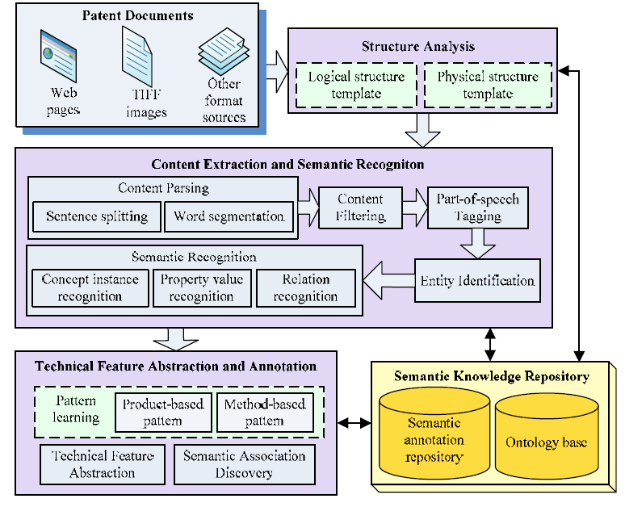
Automatic Semantic Annotation
Notes:
16

Slide 17
Discussion
Discussion
Multi-level semantic representation
Allow the precision information extraction
Leverage NLP and domain knowledge
Document type dependent
Difficult to generalize
Notes:
17

