Slide 1
Learning part-of-speech taggers with inter-annotator agreement loss
EACL 2014
Barbara Plank, Dirk Hovy, Anders Søgaard
University of Copenhagen
Presentation: Ben Glass, Cincinnati Children’s Hospital

Slide 2
- Inter-annotator agreement
- The idea
- Defining agreement scores
- Baseline classifier
- Adding the agreement scores
- Results
- Conclusion
- Discussion

Slide 3
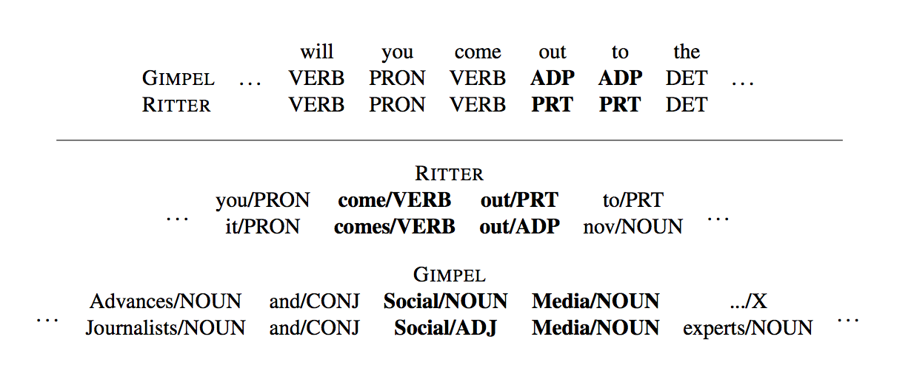
Inter-annotator Agreement

Slide 4
The Idea
1) Measure inter-annotator agreement per class over a portion of the training set
2) During training use agreement score for the current label (gold/predicted/both?) in the loss function

Slide 5
Agreement Score 1: Annotator F1
Harmonic mean of:
Prec_{T} (A₁(X), A₂(X))
#(A₁ and A₂ both give label T) /
#(A₁ gives label T)
and Rec_{T} (A₁(X), A₂(X))
#(A₁ and A₂ both give label T) /
#(A₂ gives label T)
In other words: normal precision and recall but use 2nd annotator instead of gold standard

Slide 6
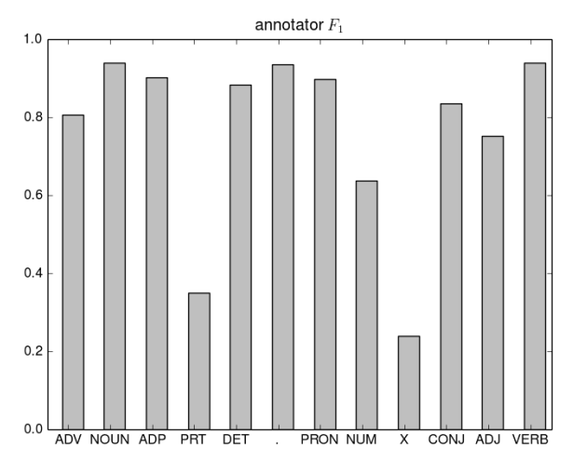

Slide 7
Agreement Score 2: Confusion Probability
P({A₁(x), A₂(x)} = {t₁, t₂})
probability of confusing tags t₁, t₂
= mean of P(A₁(x) = t₁, A₂(x) = t₂)
and P(A₁(x) = t₂, A₂(x) = t₁)
In other words: probability that A₁ assigns a certain tag and A₂ the other, and vice versa

Slide 8
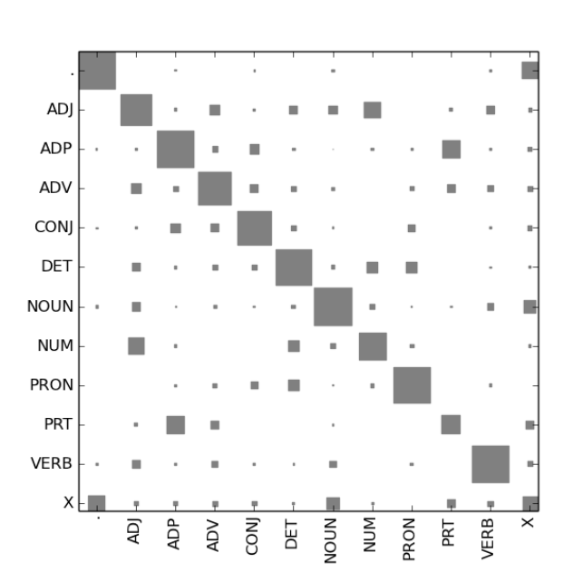
Confusion Probability

Slide 9
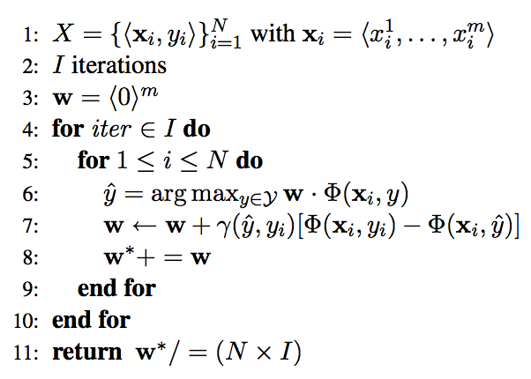
Baseline Classifier
Online structured perceptron

Slide 10
Adding the Agreement Measures
Annotator F1:
γ(y_{j} , y_{i}) = F1_{yi}(A₁(X), A₂(X))
(gold label only)
Inverse confusion probability:
γ(y_{j} , y_{i})) = 1 − P( {A₁(X), A₂(X)} = {y_{j} , y_{i}} )
(both gold and predicted)

Slide 11
Results

Slide 12
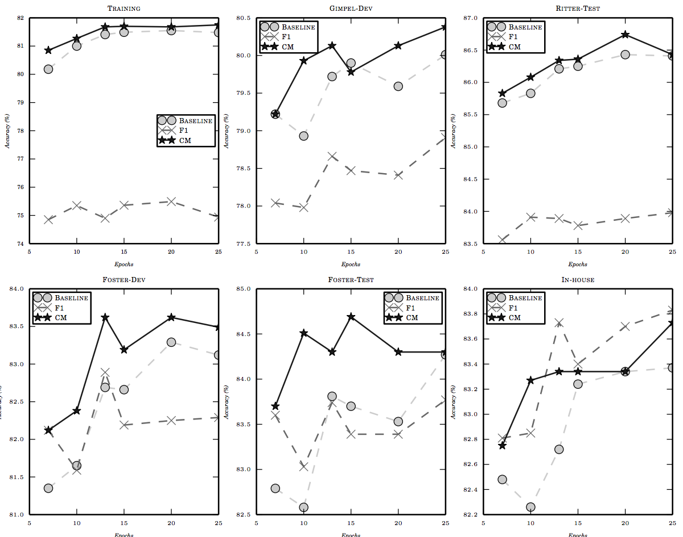
Results

Slide 13
Results: regularization

Slide 14
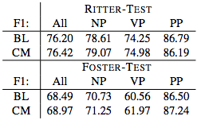
Results: downstream
Chunking
Named entity recognition

Slide 15
Conclusion
- Taking inter-annotator agreement into account during training can improve classifier performance
- While this paper focused on POS tagging, the methods described could potentially be applied to biomedical tasks involving human-annotated training data

Slide 16
Discussion
- Confusion probability for > 2 annotators ?
- Asymmetric confusion probability ?
- Results for individual classes ?
- Compare to “remove hard cases” method ? Other existing cost-sensitive algorithms ?

Slide 17
Plank, B., Hovy, D., & Søgaard, A. (2014). Learning part-of-speech taggers with inter-annotator agreement loss. In Proceedings of EACL.

