Slide 1
Review:
Translating without in-domain corpus: Machine translation post-editing with online learning techniques
Antonio L. Lagarda, Daniel Ortiz-Martínez, Vicent Alabau, Francisco Casacuberta
Lagarda, A.L., et al., Translating without in-domain corpus: Machine translation post-editing with online learning techniques. Comput. Speech Lang. (2014), http://dx.doi.org/10.1016/j.csl.2014.10.004

Slide 2
Outline
Overview/Background
Methods
Results
Discussion/Conclusion
Application

Slide 3
Overview / Background

Slide 4
Overview / Background
Need for high quality translation for variety of corpora
Manual translation expensive
Machine Translation is not perfect
Specialized corpora pose problems due to lack of training data in reliable Machine Translation systems
Notes:
Domian corpora for training expensive

Slide 5
Overview / Background
Popular solutions:
  W/O Resources
    Manual translation
  WEB
    Web-based translation app., with post-editing
  RBMT
    Rule Based Machine Translation, with post-editing
  SMT
    Statistical Machine Translation, with post-editing
Notes:
Most solutions use some post editing element, the goal of the study is to identify which editing method works best

Slide 6
Methods & Study Design

Slide 7
Scenario
Study Scenario
  Comparing the popular solutions with an automatic post-editing module (APE)
  Domain Adaptation as an APE problem
  Typical APE
    Translation System employed
    Statistical APE processes system output
  Results calculated in BLEU score

Slide 8
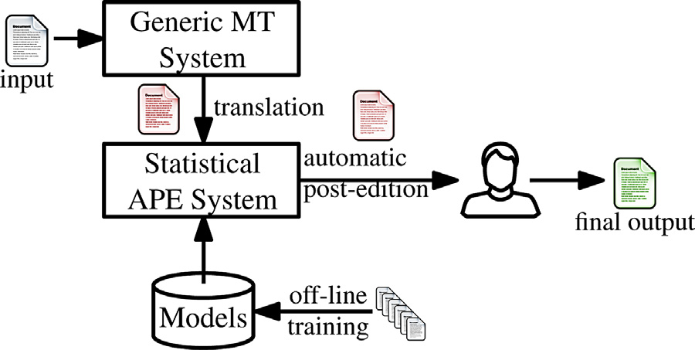
Methods
Typical setup of MT with APE system (Fig.1)

Slide 9
Methods
APE is set up in an online learning framework
  Base translation system employed
  User validates/corrects sampled translations
  User validated output is included in retraining the models for translation system
    Updated models apply to successive sentences
Notes:
Online learning is essentially active learning, incrementally more training examples one pass at a time, previous examples are not revised

Slide 10
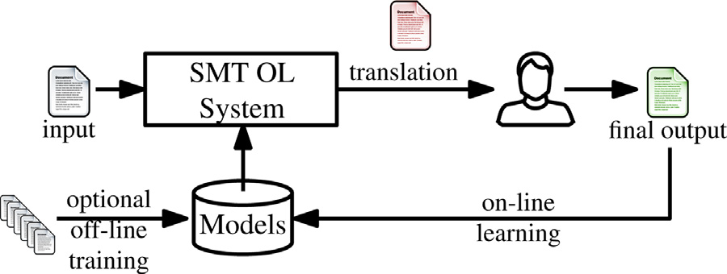
Methods
SMT with Online Learning/Active learning (Fig. 2)

Slide 11
Study Design
Base Translation Systems
  w/o Resources – “THOT” Online Learning SMT
  (no translation memory, dictionary or trained models)
  RBMT : 2 for each language pair
  WEB : Google, Bing, Yandex
  SMT : Moses – open source tool kit
  Oracle : in domain Moses-trained SMT.

Slide 12
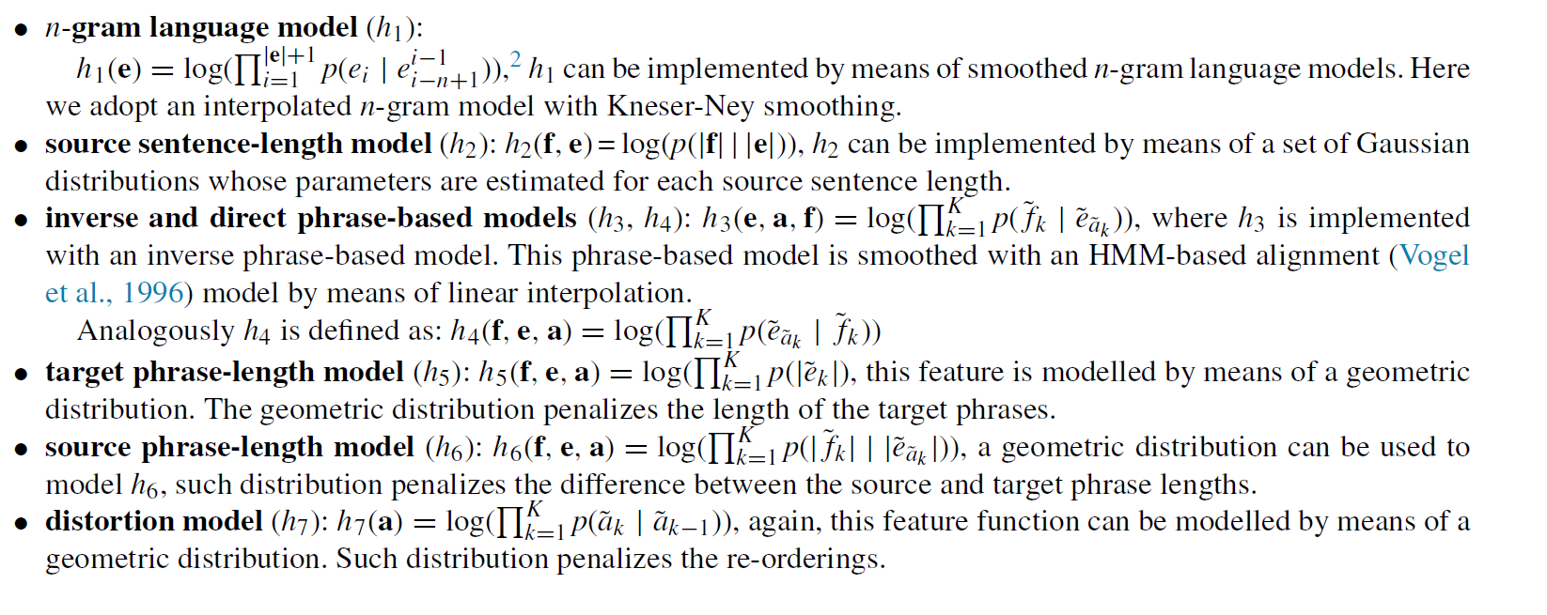
Study Design
Active Learning Automatic Post Editor
  SMT
    Simplified log-linear model to generate translations
    Feature Functions:

Slide 13
Study Design
Active Learning APE
  SMT
    Log-linear model extended from user feedback
    Incremental EM (expectation maximization) algorithm (convergence after each training sample)
    Differs from previous work by word alignment
      Word alignment used is based on HMM vs edit distance (rule)
      WA integrated in online SMT
      Estimated by the incremental EM

Slide 14

Evaluation Metrics
Results calculated in BLEU score
  BiLingual Evaluation Understudy
Usually N=4
Papineni, K., Roukos, S., Ward, T., Zhu, W.-J., 2002. Bleu: a method for automatic evaluation of machine translation. In: Proceedings of ACL,Philadelphia, PA, USA, pp. 311–318.
Notes:
Geometric mean of precision of ngrams of various lengths between hypothesis (system) and set of reference translations
multiplied by a factor BP(.) that penalizes short sentences.
p%n – precision of ngrams

Slide 15
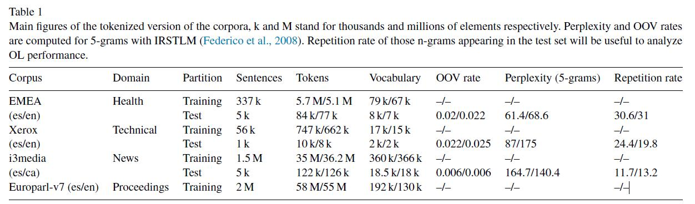
Corpora
4 Corpora
Xerox – non-public source
Europarl - popular multi lingual MT source
used for Out of Domain Training
Language Pairs:
Spanish (es) English (en)
Spanish (es) Catalan (ca)

Slide 16
Results

Slide 17
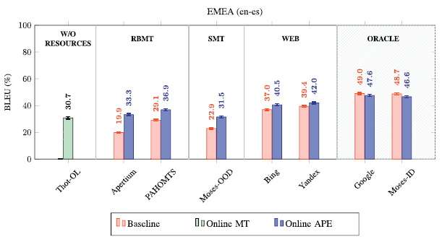
Results
EMEA (Health) (fig. 3)
  English -> Spanish (reverse results same)
Notes:
w/o resources is a SMT with no training data. Just online learning, so starting from blank models
‘Oracle’ – gold standard not used because this is still a MT system

Slide 18
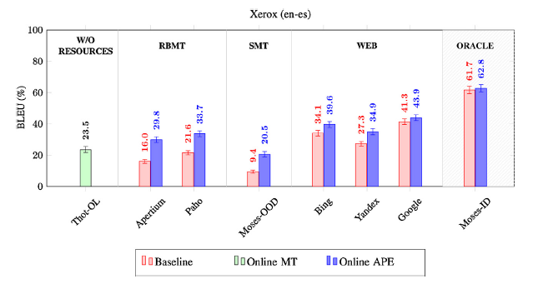
Results
Xerox (Technical) (fig. 5)
  English -> Spanish (reverse results similar,
  slightly worse)

Slide 19
Results
Xerox (Technical) (fig. 5)
  English -> Spanish (reverse results similar,
  slightly worse)
not stat. significant

Slide 20
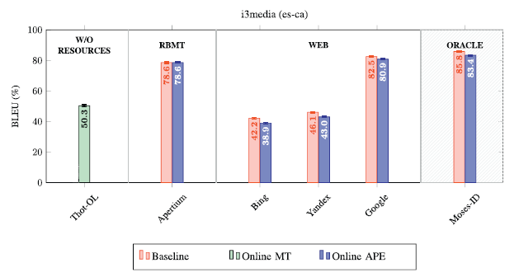
Results
I3media (News) (fig. 7)
  Spanish -> Catalan (reverse results similar)
Notes:
High baseline, similar languages Catalan – Spanish; BLEU 16 without a single word change

Slide 21
Discussion and Conclusion

Slide 22
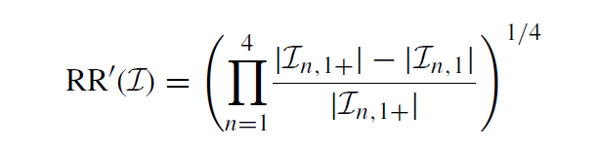


Discussion & Conclusion
Repetition Rate
  Measures the degree of document-internal repetition for a given corpus
  Rate of non singleton n-grams in a given text
set of different n-grams contained in-domain corpus I
set of different n-grams occurring only once in I
Notes:
Original repetition rate they cite used a sliding window of 1000 words, but they decide to calculate the entire text for a real scenario
(Rates of non-singleton ngrams in original are calculated and geometrically averaged)

Slide 23
Discussion & Conclusion
Repetition Rate
  High Repetition = Active Learning success
  Low Repetition = more work for editor
  Baseline Online MT highly correlated to repetition rate
  Exception: i3media (news)
    High variability in sub-domains
    Small documents, each documents repr
    95% docs < 30 sent
Notes:
Green – Baseline Online MT
Blue – Baseline Blackbox MT (no online)
Red – Online APE system output
B> red, OL not helpful
G> red OL doesn’t benefit from APE over black box

Slide 24
Application
Disparate subdomains in clinical notes
Evaluation of repetition can assess whether Active Learning methods can work for multiple tasks
  Named Entity Recognition
    Most frequently occurring NE Pre-Annotation project
SMT - phrase-based translation
  Phrase-based NE and Dx prevalent in clinical notes
Notes:
Other examples in Pestian lab?

