Slide 1
Automated systems for the de-identification of longitudinal clinical narratives: Overview of 2014 i2b2/UTHealth shared task Track 1
Amber Stubbs, Christopher Kotfila, Ozlem Uzuner
Journal of Biomedical Informatics
DOI: 10.1016/j.jbi.2015.06.007

Slide 2
3 previous tools
- Tested on 2006 i2b2 Data
MIST (Mitre)
  Identify PHI using Carafe
  (CRF model trained for text processing)
  0.978 P, 0.951 R, 0.965 F
BoB (Best of Breed VA)
  Using Apache UIMA/cTAKES
  1st Rules and CRF model
  2nd SVM filtering
  0.846 P, 0.965 R, 0.902 F
In-House, CCHMC
  Preprocessing (tree tagger POS)
  CRF models
  Post processing rules
  (email, ssn, lexicon, recognized names)
  0.968 P, 0.934 R, 0.951 F

Slide 3
Data & PHI
1304 Medical Notes for 296 Diabetic Patients
  Partners Healthcare
  PHI removed and replaced with surrogates
PHI Categories: Type (phi)
  Name (patient, doctor, username)
  Profession
  Location (room, department, hospital, org, street, city, state, country, zip, other)
  Age
  Date
  Contact (phone, fax, email, url, ipaddress)
  IDs (SSN, MRN, Health Plan, Acct Num, DL, Veh ID, Device ID, Biometr)
Notes:
Phi mostly corresponded to HIPAA category, annotated

Slide 4
HIPAA PHI
HIPAA PHI Categories: Type (phi)
  Name (patient, doctor, username)
  Profession
  Location (room, department, hospital, org, street, city, state, country, zip, other)
  Age
  Date
  Contact (phone, fax, email, url, ipaddress)
  IDs (SSN, MRN, Health Plan, Acct Num, DL, Veh ID, Device ID, Biometr)
Notes:
Phi mostly corresponded to HIPAA category, annotated

Slide 5
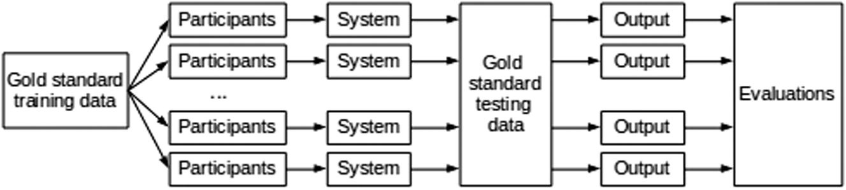
Standard Shared Task Design
May 2014
2/3 Training Data
June 2014
1/3 Training Data
July 2014
Test Data
3 days

Slide 6
Evaluation
P,R,F
Token and Entity
Micro-averaged F as primary metric
Evaluated HIPAA and non-HIPAA separately
AppRan for Stat significance
Notes:
Entity matches beginning and end exactly, as well as tag name and type attrib, token based matches tags name and type, per token basis eval

Slide 7
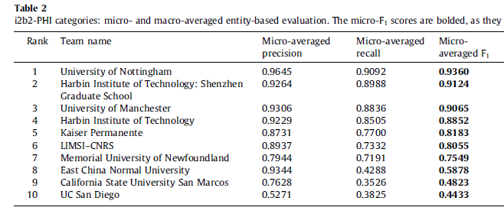
Entity Results

Slide 8
Top 3 Systems
Nottingham (UK) (Micro F 0.936)
  Preprocessed data (Sentence split,Tokenization,POS,Shallow Parsing)
    Features:
    word-token, context, orthograph, sentence-level, lexicons
  CRF trained
  Regular Expression & Dictionaries
  Post-Processing
    Entity extraction from
      identified PHI
      PHI lex to discover more terms
        Built from types of relations from detected PHI terms
Notes:
Context: lemma, pos, chunk of nearby tokens
Orthography: Cap, Punct, Regex for Dates, usernames
Sentence: position in sentence, section headers
Lexicons – us names, title clues

Slide 9
Top 3 Systems
Harbin (China) (Micro F 0.912)
  CRF based on token level features
    Extracted from MedEx for token
    Bag-of-words, POS, orthographic, section, word representation
  CRF based on character level (split sentences into char, instead of tok)
  Rules: phone, fax mrn
  Post Process Rules: merge output of three above
  Hierarchy - 1: Rule, 2: Char CRF, 3:Tok CRF
Notes:
Not stat sig with harbin

Slide 10
Top 3 Systems
Manchester (UK) (Micro F 0.907)
  cTAKES + GATE
    Tok, sentence, pos, chunk
  Knowledge driven system
    Dictionaries with small set of rules (orthog, pattern, neg, lex, context features)
  CRF model for each category (city, date, hosp, org, profess, pat)
    Lexical, orthog, semantic (dict match related), positional,
  2 Pass approach for PT, DR, Hosp, City, MRN, ID Num
    Extracted initial @ pt-level > pt dictionary,
    2nd pass dictionary match for all entities missed for that patient
  Merge outputs
Notes:
Not stat sig with Harbin

Slide 11
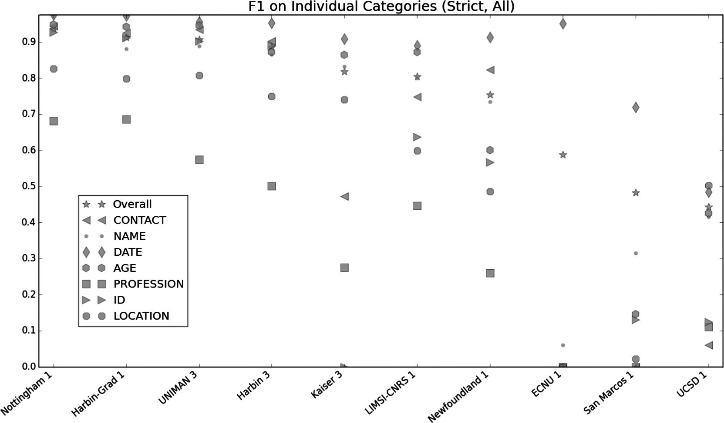
Entity Performance
Fig. 1
Notes:
Micro-averaged entity-based micro-averaged F1 measures by category: i2b2-PHI categories.

