Slide 1
An Ontology-based Automatic Semantic Annotation Approach for Patent Document Retrieval in Product Innovation Design
Feng Wang, Lanfen Lin, Zhou Yang
College of Computer Science
Zhejiang University
Energy Procedia 13(2011) 790-800

Slide 2
Outline
Outline
  Background
  Semantic representation
  Automatic semantic annotation
Notes:
2

Slide 3
Product innovation design
Background
  Brain storming
  Literature review
  Build on existing inventions and develop novel technologies/products
Notes:
3

Slide 4
Literature review
Background
  Refer to existing and relevant patent documents
  Professional patent retrieval tools
    PatentCafe – keywords and Boolean operator search
    BioPatentMiner – keywords and query linkage
    SooPAT – keywords and International Patent Classification code
    Etc.
  Semantic representation is rarely used
Notes:
4

Slide 5
Background
Structure
Domain
Content (concepts)
Syntax (relations)
Notes:
5

Slide 6
Semantic representation
Semantic Representation
Notes:
6

Slide 7
Patent Document
Semantic Representation
Notes:
7

Slide 8
Patent ontology
Semantic Representation
  Patent structure ontology
    Specific document structure
    First page, description, claims, figures (media), etc
Notes:
XML parsing + Regular expression
8

Slide 9
Patent ontology
Semantic Representation
  Patent structure ontology
    Specific document structure
    First page, description, claims, figures (media), etc
  Patent content ontology
    Basic parameter ontology
Notes:
9

Slide 10
Patent ontology
Semantic Representation
  Patent structure ontology
    Specific document structure
    First page, description, claims, figures (media), etc
  Patent content ontology
    Basic parameter ontology
    Technical feature ontology
Notes:
10

Slide 11
Semantic representation
Semantic Representation
  Patent structure ontology
    Specific document structure
    First page, description, claims, figures (media), etc
  Patent content ontology
    Basic parameter ontology
    Technical feature ontology
  Common oncology = syntax
  Domain oncology = domain-specific terms
Notes:
11

Slide 12
Patent document semantics
Semantic Representation
Notes:
12

Slide 13
Automatic semantic annotation
Automatic Semantic Annotation
  Structure level
    Pre-defined template schemes
    Regular expression-based parsing
    Logical structure: basic parameters, description, claim, etc
    Physical structure: headings, sections, subsections, body, etc
  Content level
  Technical feature level
Notes:
13

Slide 14
Automatic semantic annotation
Automatic Semantic Annotation
  Structure level
  Content level
    Content parsing & filtering: filter out irrelevant sentences
    POS tagging: identify nouns, verbs, etc
    Entity identification: pick up nouns and verbs
    Semantic Recognition
      Concept recognition: select nouns by domain oncology (using IPC codes)
      Relation recognition: using common oncology
  Technical feature level
Notes:
14

Slide 15
Automatic semantic annotation
Automatic Semantic Annotation
  Structure level
  Content level
  Technical feature level
    Regular expression method + active learning
    prefixTerms + pattern + postfixTerms
      A “associated with” B
    Given prefixTerms/postfixTerms, learn new patterns
      A “is a component of” B
    Heuristic rules to remove unreasonable patterns
Notes:
15

Slide 16
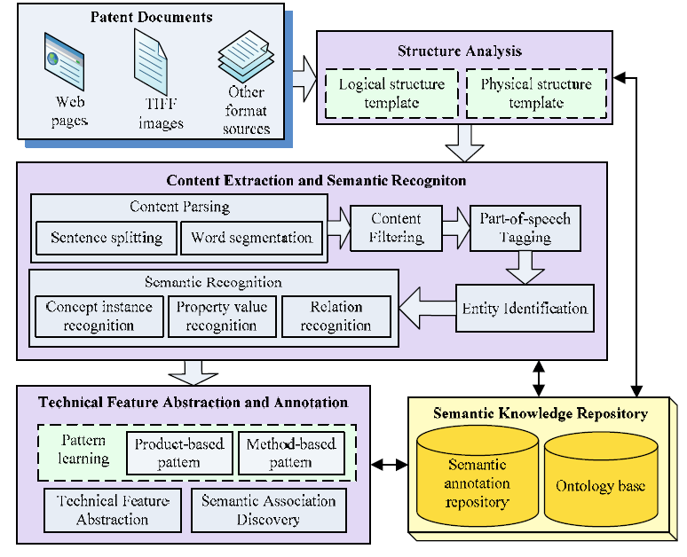
Automatic Semantic Annotation
Notes:
16

Slide 17
Discussion
Discussion
  Multi-level semantic representation
    Allow the precision information extraction
  Leverage NLP and domain knowledge
  Document type dependent
    Difficult to generalize
Notes:
17

