Slide 1
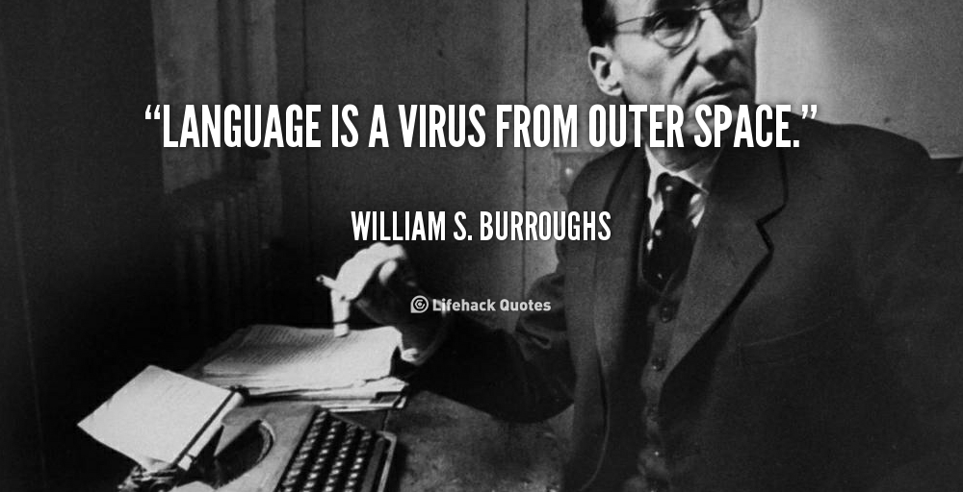
Mayo Clinic Smoking Status Classification System: Extensions and Improvements
A Study of Transportability of an Existing Smoking Status Detection Module across Institutions
Brian Connolly
Pestian Journal Club
3/7/14

Slide 2
Why They Are Interesting
Sohn S, Savova GK. Mayo clinic smoking status classification system: extensions and improvements. AMIA Annu Symp Proc. 2009;2009:619–623
  Overview of cTAKES smoking status classification system
Mei Liu, PhD, Anushi Shah, MS, [...], and Hua Xu, PhD. Study of Transportability of an Existing Smoking Status Detection Module across Institutions. AMIA Annu Symp Proc. 2012; 2012: 577–586
  Multi-institutional

Slide 3
Mayo Clinic Smoking Status Classification System: Extensions and Improvements

Slide 4
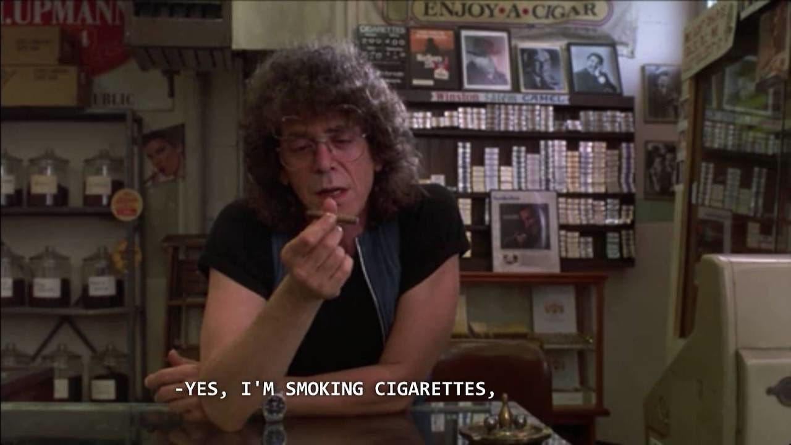
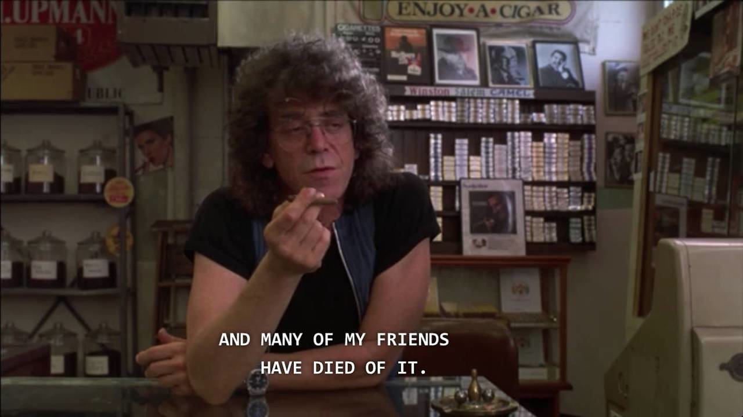
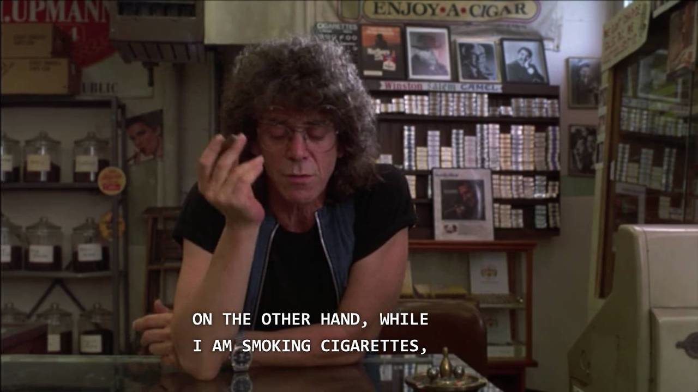
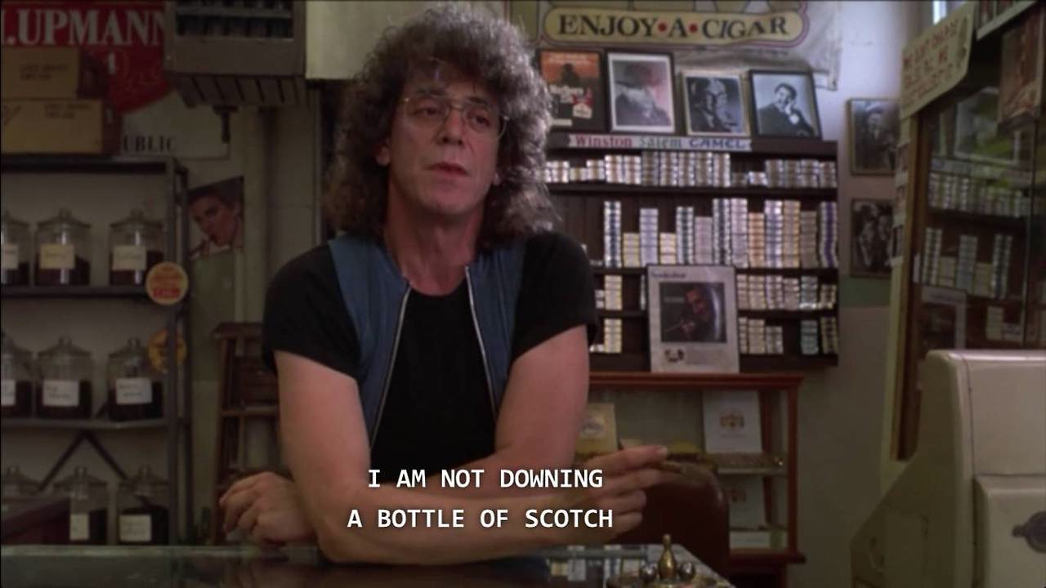
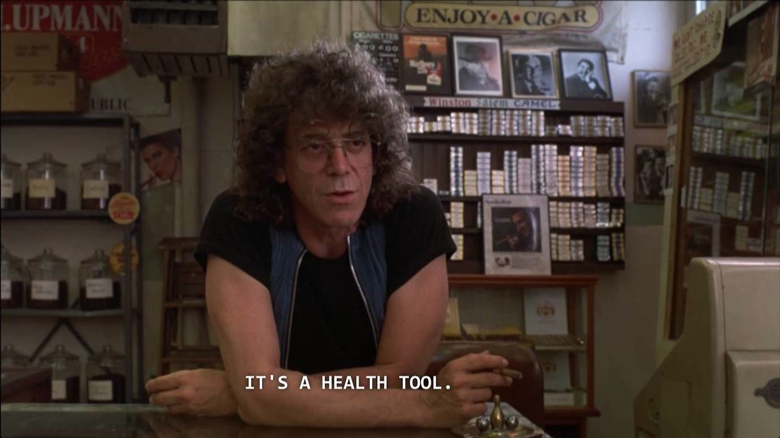
Why Extract Smoking Status?
Patient smoking status information not often recorded as structured field in EMR
Researchers often manually review charts to extract it
ICD9 codes
  305.1 Tobacco Use Disorder: Cases in which tobacco is used to the detriment of a person's health or social functioning or in which there is tobacco dependence. Dependence is included here rather than under drug dependence because tobacco differs from other drugs of dependence in its psychotropic effect. Tobacco Dependence—See Tobacco Use Disorder above Excludes: History of tobacco use (V15.82)
  V15.82 History of Tobacco Use: Excludes: Tobacco dependence (305.1)

Slide 5
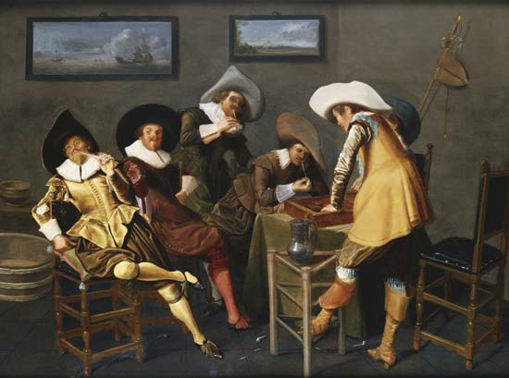
History
Mayo Clinic NLP system for smoking status identification first developed for 2006 I2B2 challenge
Smoking Status Discovery challenge: Can a patient’s smoking status be automatically and correctly identified from clinical notes DISCHARGE SUMMARIES FROM THE MAYO CLINIC?
  Past smoker (P) – haven’t smoked for 1 year
  Current smoker (C) – smoked in past year
  Smoker (S) – not enough info to classify as P or C
  Non-smoker (NS)
  Unknown (U)
Majority of systems used machine learning (some rule-based, others “own methods”)
Of 23 submissions, 12 had F>84%, best F=90%
Mayo’s entry
  Used both machine learning and rule-based methods
  Built within IBM’s Unstructured Information Management Architecture (UMIA)
  Used text analysis components from cTAKES (Mayo clinical Text Analysis and Knowledge Extraction System)

Slide 6

Problems with I2B2 Challenge Submission
Errors in negation detection for non-smoker
Errors in unknown smoking status assignment
Aims:
  Add non-smoker lexical markers to the non-smoker dictionary, modify negation rules
  Improving the temporal resolution features for the machine learning component for past/current smokers
  Apply keyword search for unknown cases
  Utilize metadata information such as document heading (e.g., ignore family history section )

Slide 7
“Broad General View”
Break patient documents up in to sentences using cTAKES
Three levels of classification: sentence, document, patient (goal)
Classify sentences (machine learning)
  3 classification levels
Classify documents (rule)
Classify patients (rule)

Slide 8
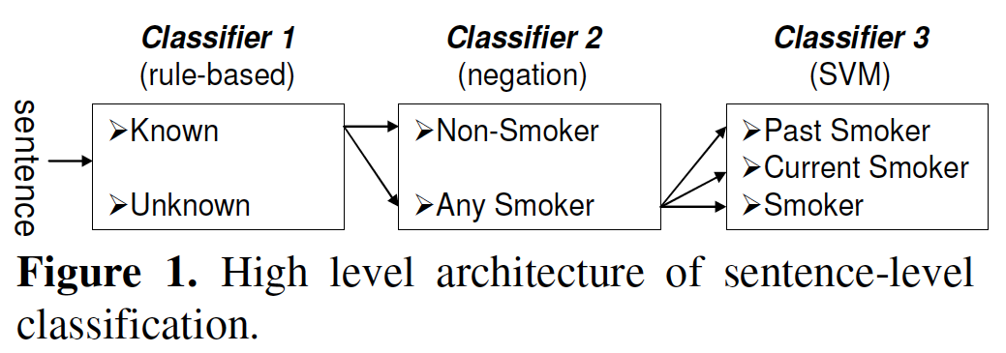
Sentence Level: 3 Sentence Classifiers
Break document into sentences using cTAKES
Look for smoke,
tobacco, cigarette,
nicotine
Extend cTAKES negation to include nonsmoker and non-smoker
Some words override negation like quit, stop and discontinue and passed to next classifier
Temporal resolution words and date indications as features
Day, month, days ago
2009, 1990’s
Smokes, quit, quits

Slide 9
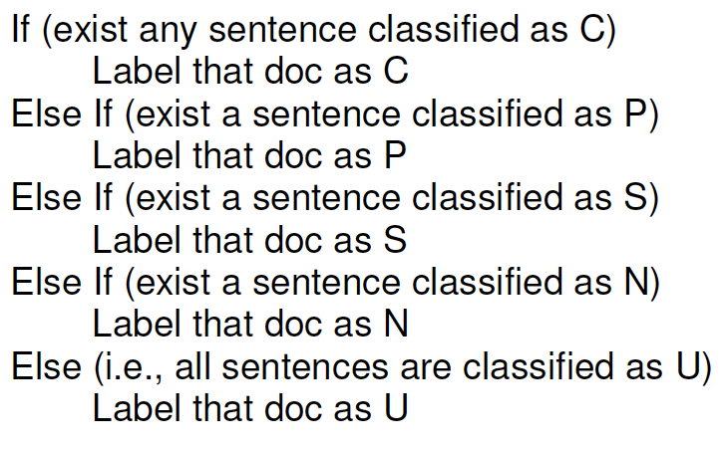

Document Level

Slide 10
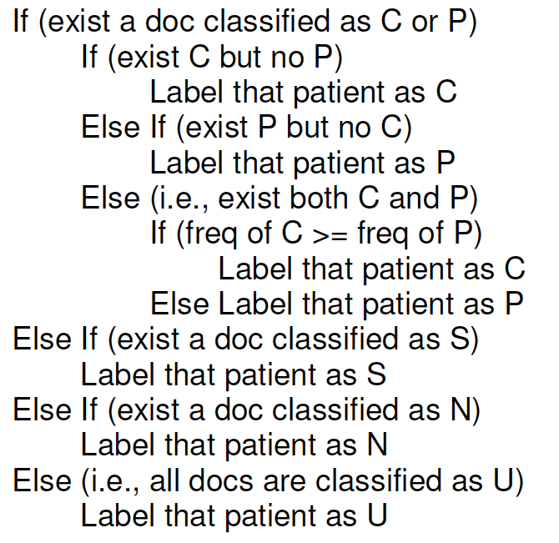
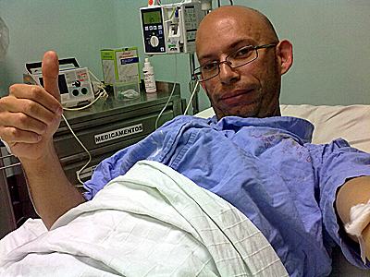
Patient Level

Slide 11
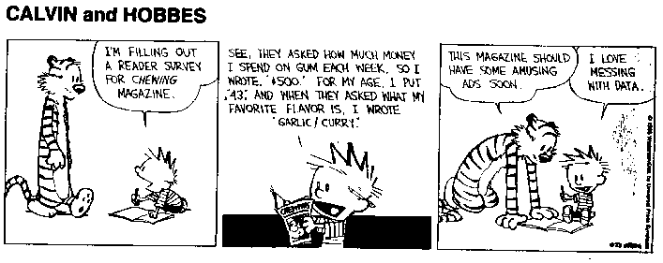
Data
Mayo clinic patients (not from I2B2 challenge)
Document Level (330 total): 56 past, 34 current, 4 smokers, 6 non-smokers, 230 unknowns
Patient Level (36 total): 16 past, 5 current, 13 non-smokers, 2 unknown
Manually assigned smoking status for Patient Level and Document Level separately

Slide 12
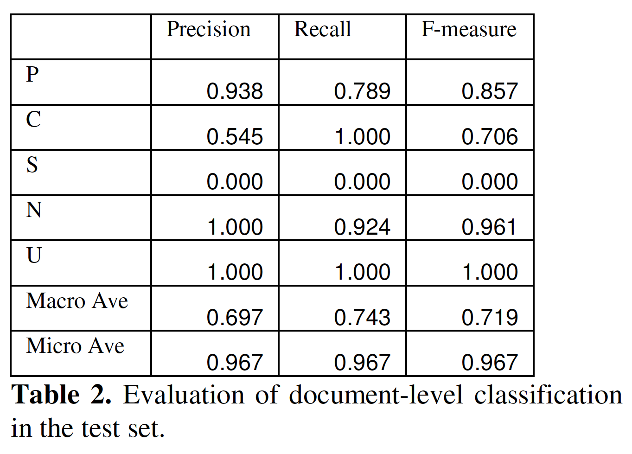
Results
WHOAA!
Averaged
over classes
(P,C,N, etc.)

Slide 13
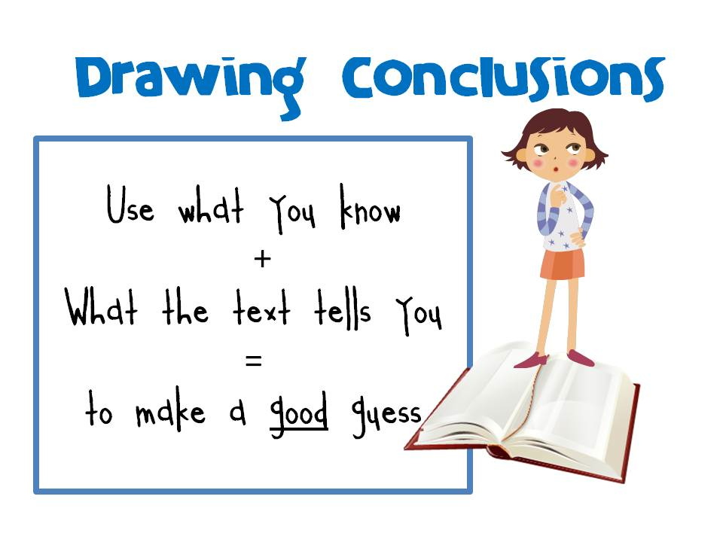
Discussion/Conclusions
Problem sentences
  “He denies any drug or tobacco use.. When he was sitting around a campfire and thinks he inhaled some smoke…”
  “She denies hx of heart problems, cp, drug use, smoking”
  “a distant smoking history” (distant not in training set)
Can’t identify smokers – big deal?
  Somewhere between current smoker and past smoker (include people with living with smoker?)

Slide 14

What have I learned?
cTAKES smoking status module
Instance where where Sentence -> Document -> Patient Level classification works
Question: How does it work in the wider world?

Slide 15
A Study of Transportability of an Existing Smoking Status Detection Module across Institutions

Slide 16
Idea
Ran cTAKES smoking status module on “cohort of” 400 patients from Vanderbilt Synthetic Derivative
Vanderbilt Synthetic Derivative = de-identified version of VUMC EMR
Only Past, Current and Non-smokers
Performance wasn’t great, mostly due to sentence-level classifier
Used problem list, history and physicals and clinical visit sections of notes
  i2b2 challenge used only discharge summaries

Slide 17
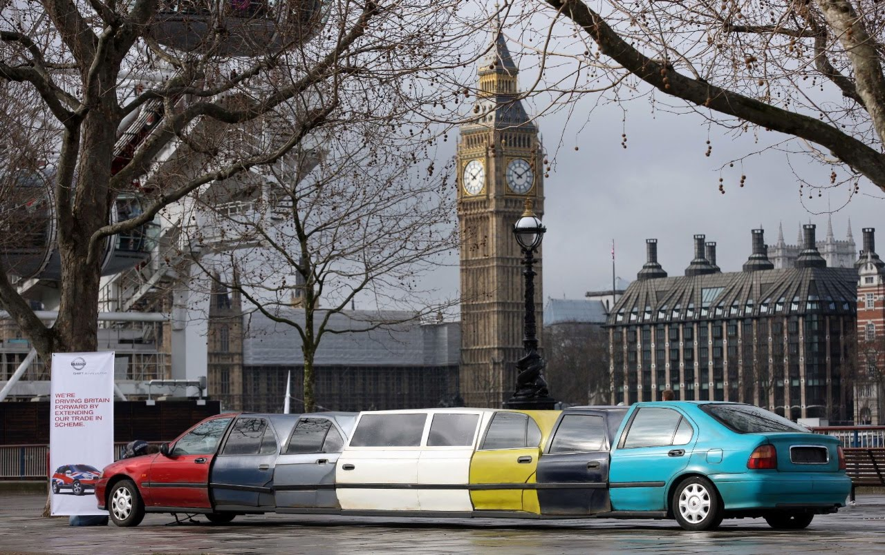
Modifications
Sentence-Level (Major Modifications)
Document-Level
Patient-Level

Slide 18
Sentence Level Modifications: 3 Sentence Classifiers
Break document into sentences using cTAKES
Look for smoke,
tobacco, cigarette,
Nicotine
Anxiety, dependence, raspy smoker’s laugh, etc.
Extend cTAKES negation to include nonsmoker and non-smoker
Some words override negation like quit, stop and discontinue and passed to next classifier
Temporal resolution words and date indications as features
Day, month, days ago
2009, 1990’s
Smokes, smokes, quit, quits
Retrained SVM

Slide 19
Document Level Modifications

Slide 20
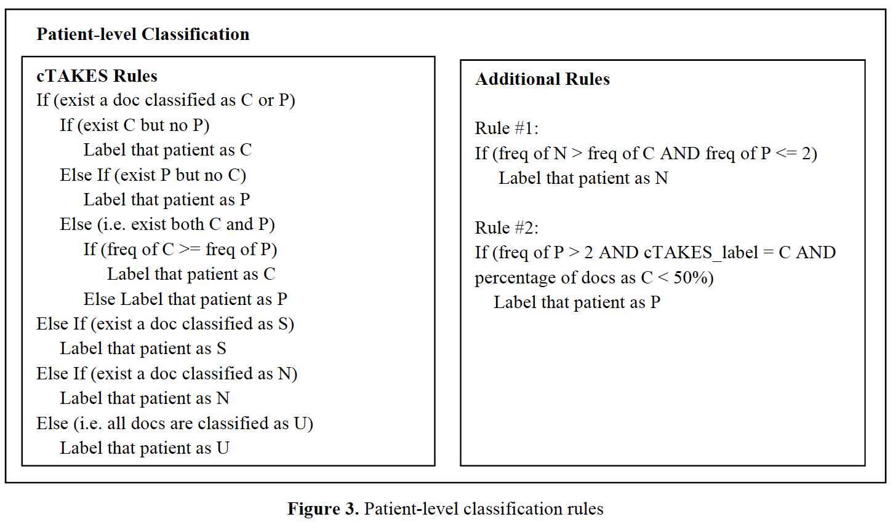
Patient Level Modifications
**KLUDGE**
N incorrectly labeled as C by comparing counts of documents labeled as C and N
Calculated percentage of documents labeled as C and used it to correct errors where P was incorrectly categorized as C by cTAKES rules

Slide 21
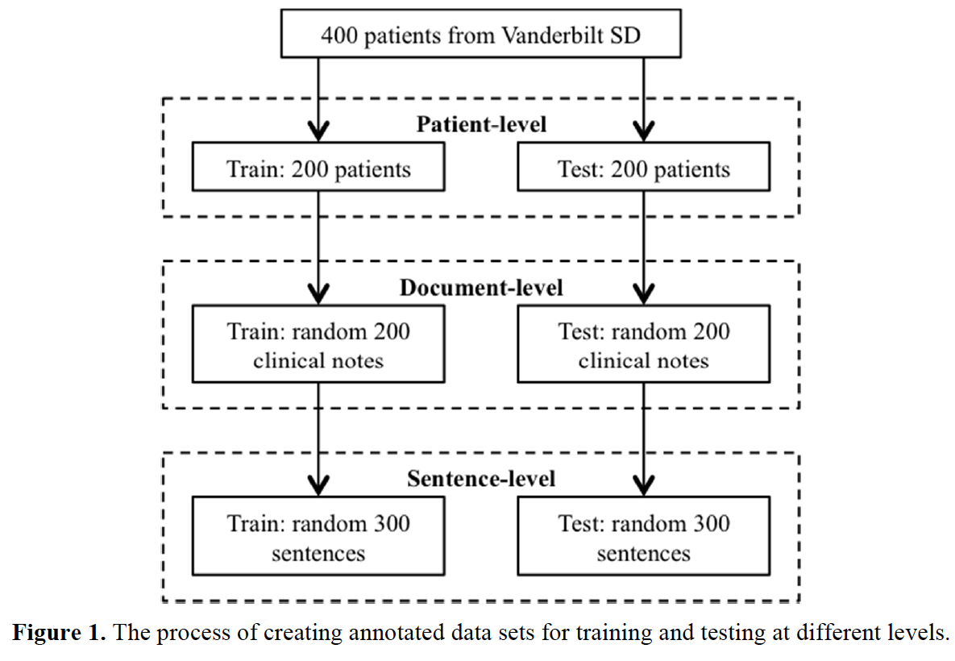
Training on Vanderbilt Data

Slide 22
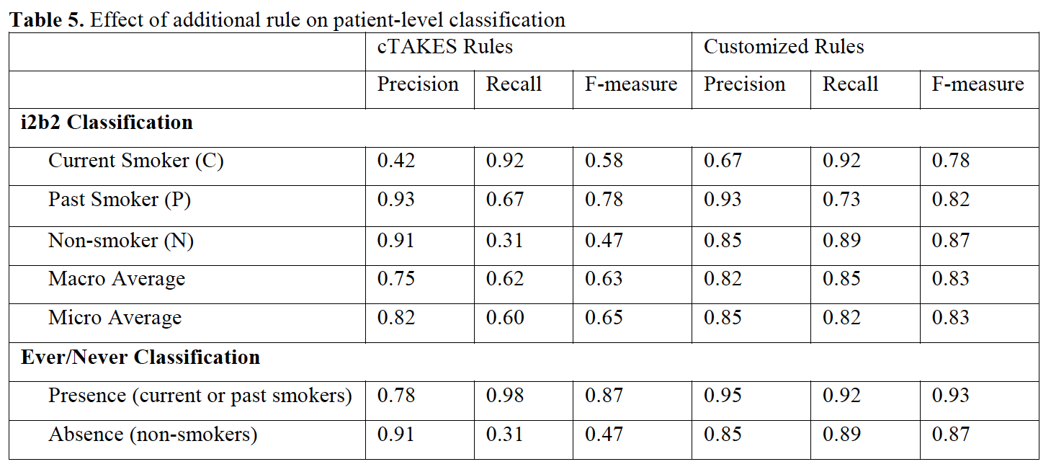
Results

Slide 23
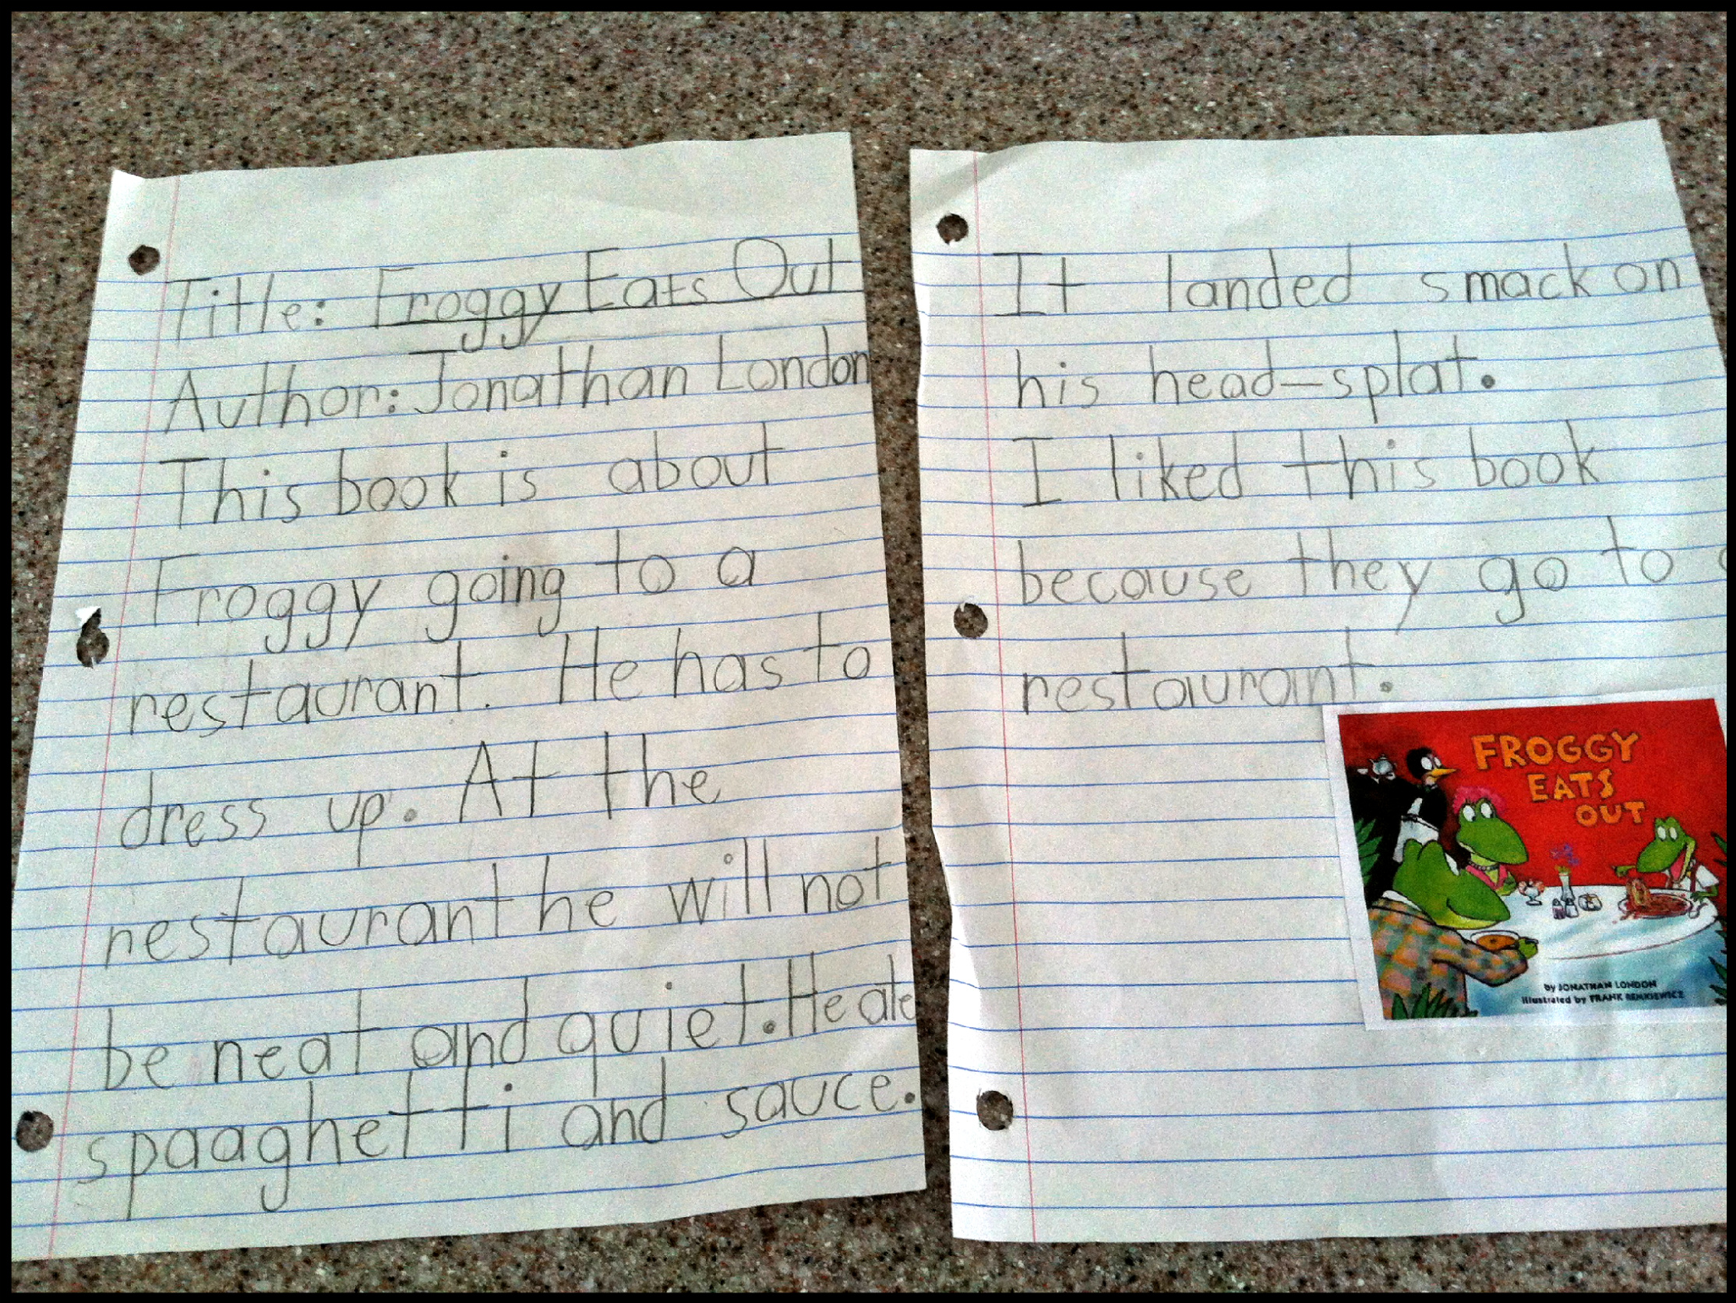
Comments
“Modest” effort of change is necessary
Not meant to expand cTAKES, only to adapt it, so modifications tell you more about Vanderbilt than smokers
E.g., didn’t optimize on BOTH Vanderbilt and Mayo
Many note types, i2b2 challenge only discharge summaries
Can’t expect (relatively simple) modules to work out of the box, even if rule-based (recall: document-level and patient-level rule based)
  Hripsak et al., small drop in MedLEE performance

Slide 24
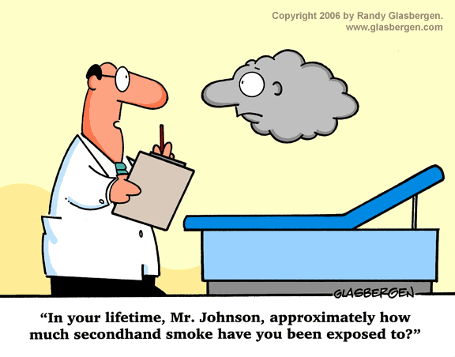
Conclusions
Adaption (not expansion) of smoking status classifier in cTAKES
Possible analyses:
  Smoking more prevalent among schizophrenics – why? (Social? Psychological? Biological? Neurobiological?)
  Veterans
    “For example, the US Veterans Administration's (VA) EHR system is the largest in the world, but offers essentially only simple text support. It is not uncommon in the VA corpus to find abbreviations or acronyms themselves misspelled.” (S. M. Meystre et al, 2008)

