Slide 1
Does one size really fit all? Evaluating classifiers in a Bag-of-Visual-Words classification
Christian Hentschel, Harald Sack
Hasso Plattner Institute for Software Systems Engineering
Potsdam, Germany
iKNOW Conference 2014

Slide 2
Introduction to the topic
Bag of Visual Words model
Classifiers
Results
Discussion
Source: xkcd.com/1425

Slide 3
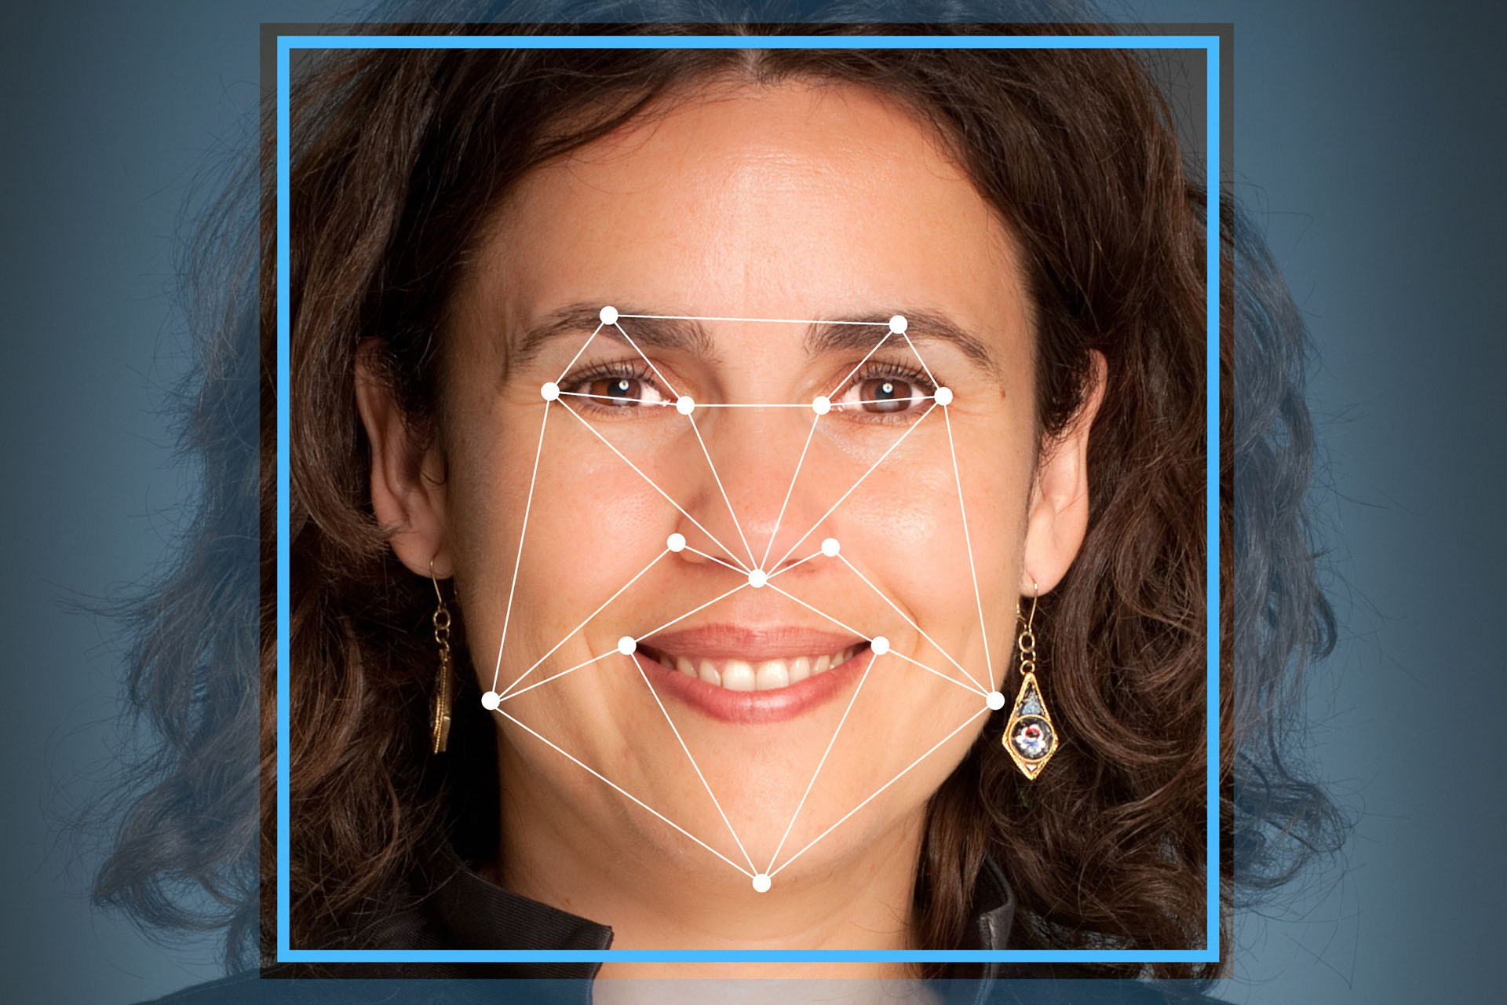
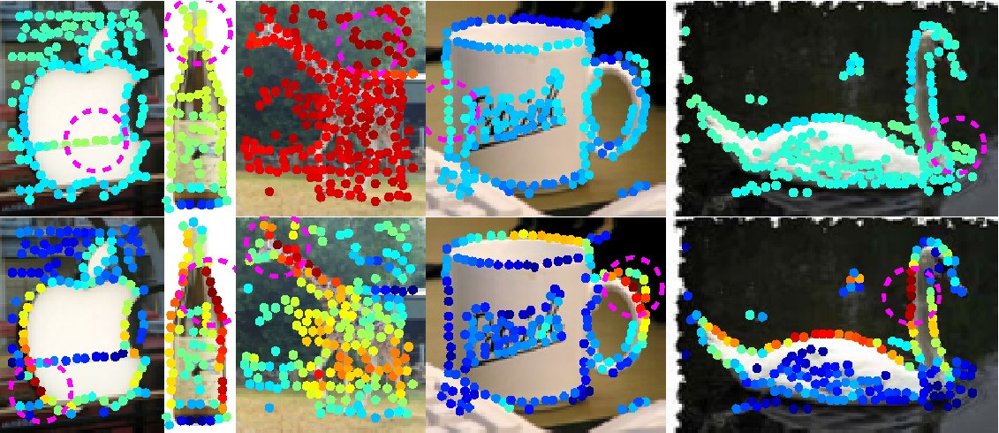
Computer Vision
Analyze images to get numeric or symbolic data
e.g. recognition - does the image contain a certain class of object
Biomedicine, defense, transportation, consumer products, manufacturing…

Slide 4
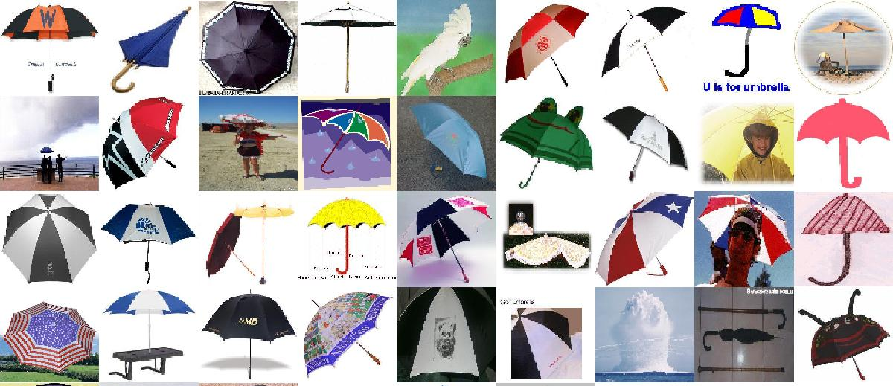
Computer vision dataset – Caltech 101
101 categories, 40-800 images per category
From simple Google Image search
One background category with other random objects (“things”)

Slide 5
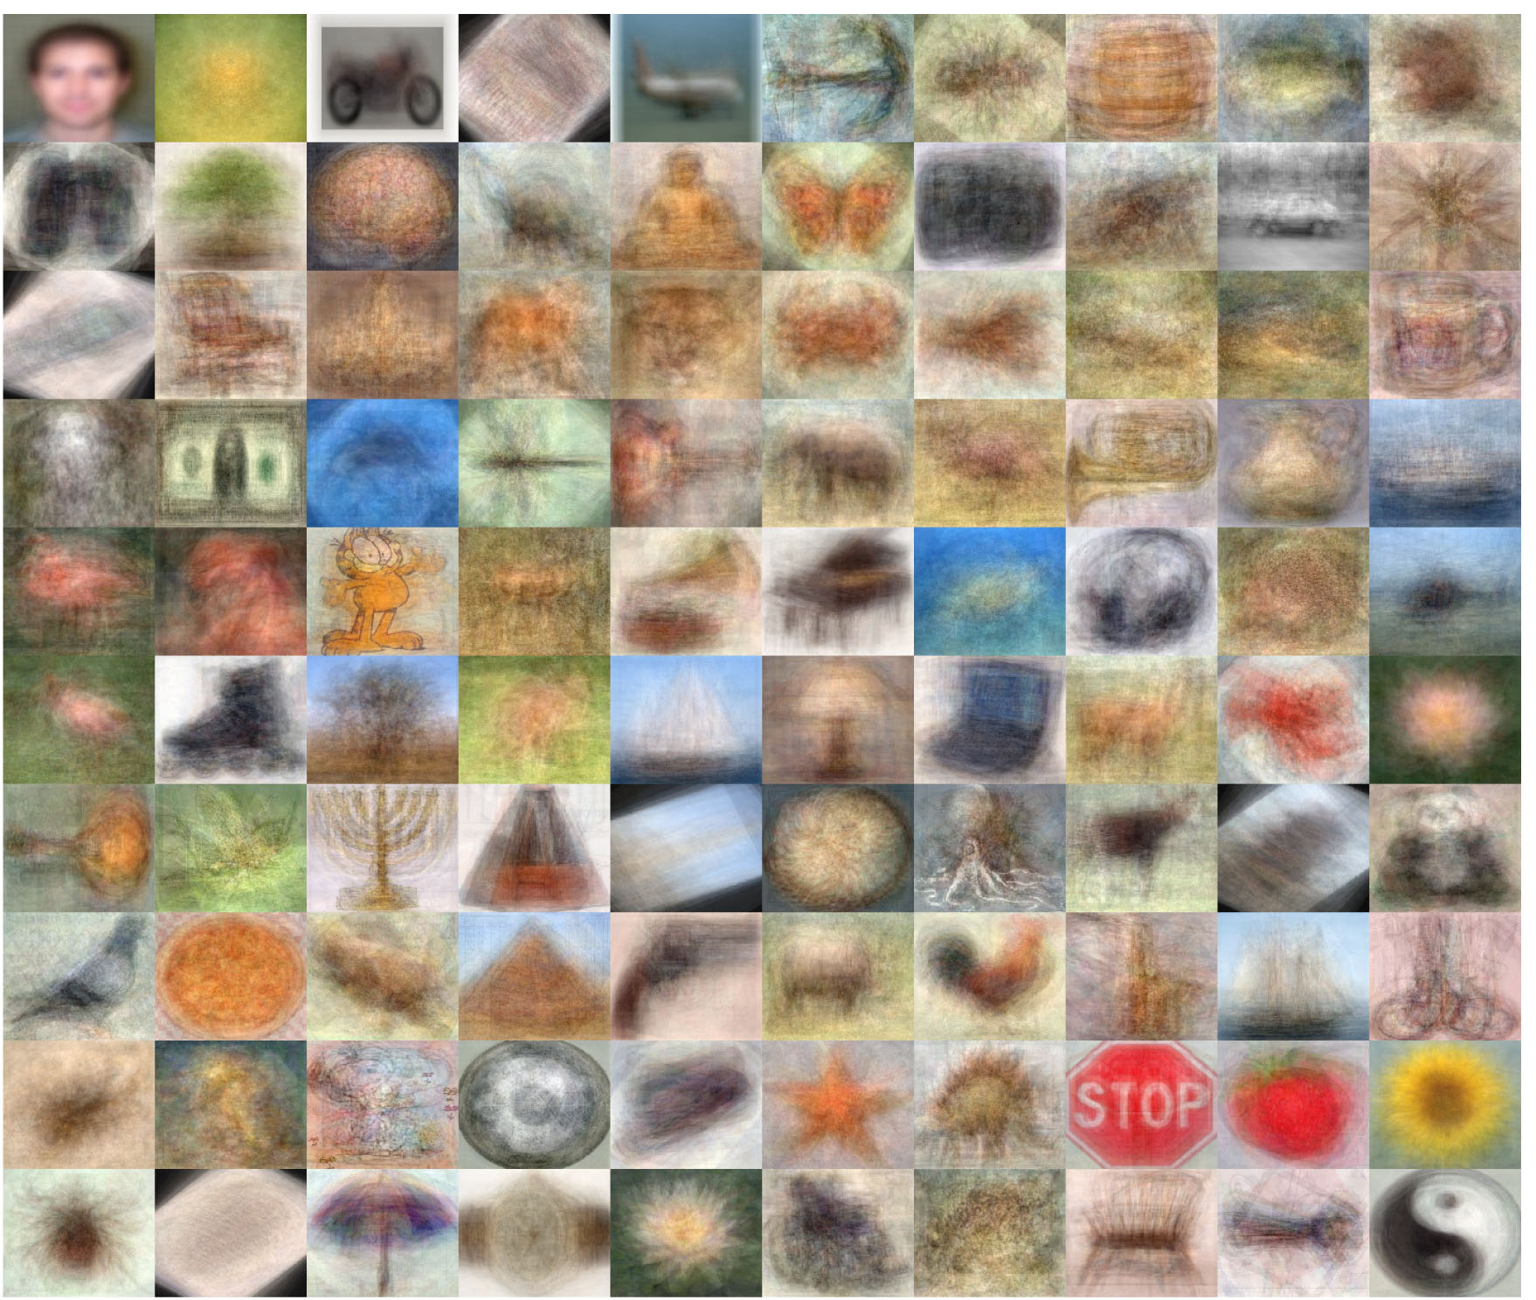

Slide 6
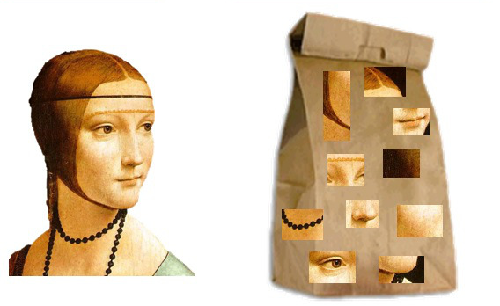
Bag-of-Visual-Words
Borrowed from text classification
Intuition: sample a bunch of pieces (“words”) from various parts of the image. Images of the same object are more likely to share similar pieces

Slide 7
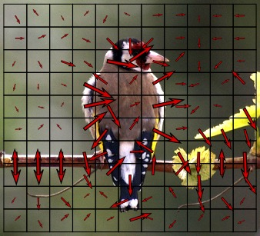
How to represent a sampled piece of the image?
Gradient Orientation
Specifically, Scale invariant feature transform (SIFT)
Problem: potentially billions of features with little variation
Answer: cluster them into “vocabulary words” with e.g. k-means

Slide 8
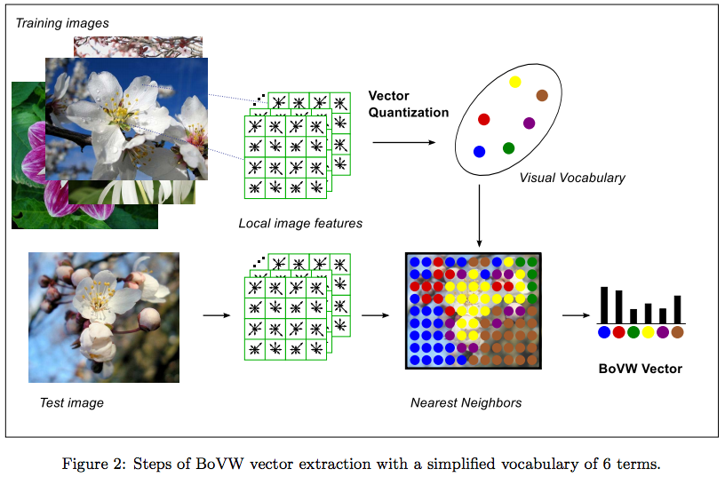

Slide 9
Classification
Compare 8 classifiers:
Naïve Bayes
Logistic Regression
K Nearest Neighbors
Random Forests
AdaBoost
SVM (linear)
SVM (Gaussian kernel)
SVM (chi square kernel)
Random sample of 800,000 features => k-means, k=100
All were scikit-learn implementations

Slide 10
Classification
50% training – 50% test
Each object category vs. “background” category (other objects)
3-fold nested cross validation to optimize hyperparameters
Report mean average precision (mAP) over all categories

Slide 11
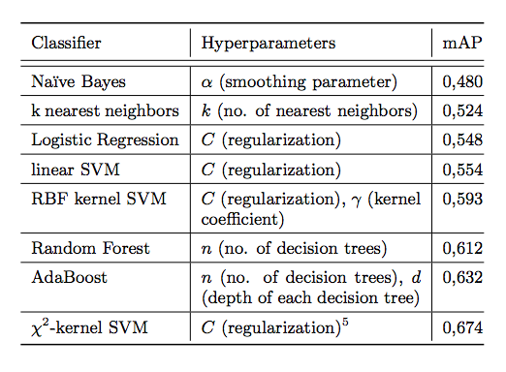
Results

Slide 12
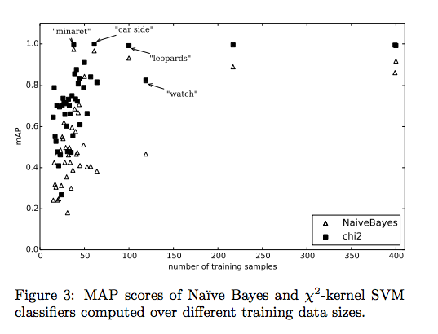
Results

Slide 13
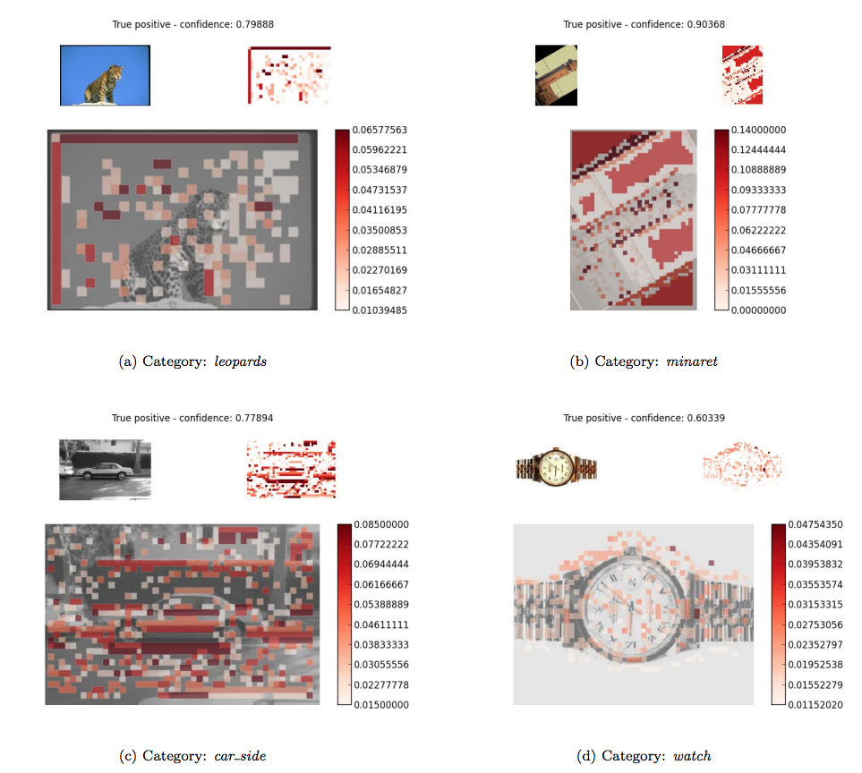

Slide 14
Discussion
Correlation of training set size to mAP
Certain categories were easy for all classifiers (‘leopard’, ‘minaret’, ‘car side’), others showed a huge performance gap (‘watch’)
Not a huge overall performance gap –
relatively easy dataset (single objects,
centered, similar scale)

Slide 15
Discussion
Confirms previous results recommending chi square SVM for BoVW
Kernel selection for SVM critical
Ensemble classifiers are a good alternative when computation time is an issue

