Slide 1
An End-to-End Computerized Algorithm for
Automated Medication Reconciliation
Qi Li, S. Andrew Spooner, Megan Kaiser, Nataline Lingren, Jessica Robbins, Todd Lingren, Huaxiu Tang, Haijun Zhai, Imre Solti, Yizhao Ni
Department of Biomedical Informatics
Cincinnati Children’s Hospital Medical Center

Slide 2
Outline
Outline
  Background & Objective
  Automated Medication Reconciliation
    Medication Entity Detection
    Attribute Linkage
    Medication Matching
  Experiments & Evaluation
  Conclusions & Future Work
Notes:
2

Slide 3




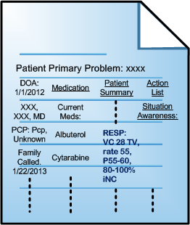
Scenario
  Medication discrepancy is prevalent (Wong, et al., 2008; Cornu, et al., 2012)
  Unintentional medication discrepancies could cause significant clinical impact (Nickerson, et al., 2005)

Slide 4
Background
Background
  Inadequate medication reconciliation
  Responsibility, outside area of expertise, complexity of reconciliation process and lack of time (Boockvar, et al., 2011)
  Most reconciliation processes are conducted manually
Notes:
4

Slide 5


Objective
Objective
Notes:
5

Slide 6
Methodology
Diagram
Machine learning-based Medication Entity Detection
Rule-based Attribute Linkage
NLP-based algorithm for Medication Matching
Notes:
6

Slide 7
Medication Reconciliation
Methodology
Diagram
Notes:
7

Slide 8
Medication Entity Detection
Methodology
Medication Entity Detection
(McCallum, 2002)
Notes:
8

Slide 9
Methodology
Medication Entity Detection
(Li, et al., 2013)
Notes:
9

Slide 10
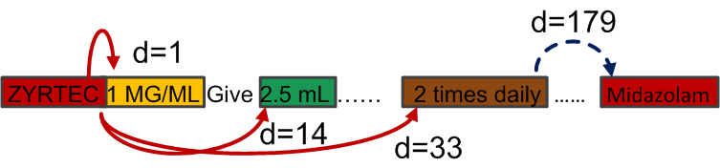
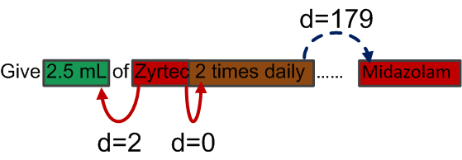
Attribute Linkage
Methodology
Attribute Linkage
Rule-based algorithm
Link attributes to the closest medication name
Simple but functions well
Notes:
10

Slide 11
Medication Matching
Methodology
Medication Matching
Notes:
11

Slide 12
Gold-standard Evaluation Data
Experiments & Evaluation
Data Source
Medication Reconciliation for Medically Complex Children
Patients | 271
Encounters | 975
Prescription Lists | 975
Notes | 4325
 | #Discrepant | #Matched | All
Medication name | 1140 | 6808 | 7968
Amount | 216 | 3207 | 3423
Dosage | 132 | 1568 | 1700
Duration | 4 | 86 | 90
Form | 42 | 3680 | 3722
Frequency | 448 | 5377 | 5825
Route | 90 | 3279 | 3369
Strength | 146 | 3373 | 3519
Overall | 2218 | 27378 | 29596
Notes:
12

Slide 13
Evaluation Metrics (Entity Detection)
Experiments & Evaluation
Evaluation Metrics
  Precision = True Positive/(True Positive+False Positive)
  Recall = True Positive/(True Positive+False Negative)
  F-value = 2 x Precision x Recall/(Precision+Recall)
  True Positive = entity identified from the note and linked to the correct medication name
Notes:
13

Slide 14
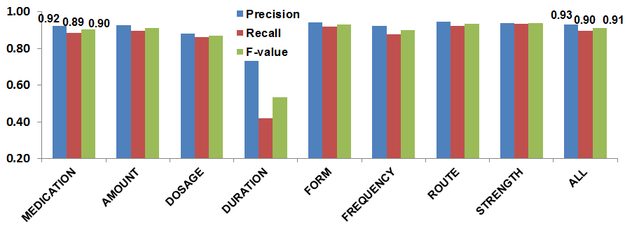
Results on All Entities
Experiments & Evaluation
Results
Entity detection & linkage – 0.93/0.90/0.91 (P/R/F)
Notes:
14

Slide 15
Evaluation Metrics (Matching)
Experiments & Evaluation
Evaluation Metrics
  Medication Matching (matched medication)
    True Positive = medication identified from the notes and matched to the correct prescription
  Medication Matching (discrepant medication)
  True Positive = medication identified from the notes and did NOT match to any prescription (i.e. file a discrepant alert)
Notes:
15

Slide 16
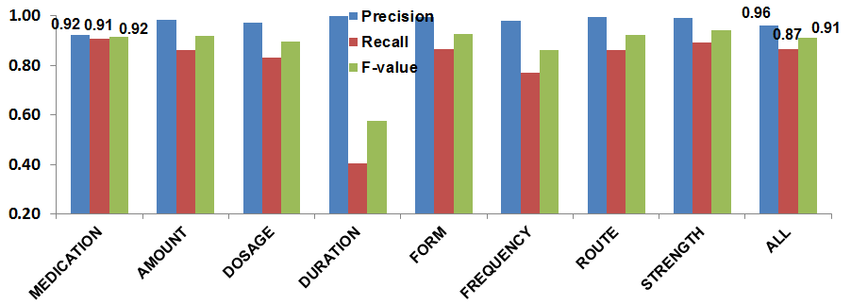
Results on Matched Medications
Experiments & Evaluation
Results
Entity detection & linkage – 0.93/0.90/0.91 (P/R/F)
Medication matching (matched) – 0.92/0.91/0.92 (P/R/F)
Notes:
16

Slide 17
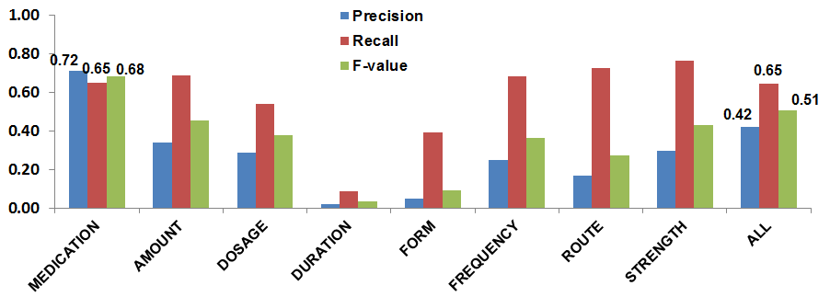
Results on Discrepant Medications
Experiments & Evaluation
Results
Entity detection & linkage – 0.93/0.90/0.91 (P/R/F)
Medication matching (matched) – 0.92/0.91/0.92 (P/R/F)
Medication matching (discrepant) – 0.72/0.65/0.58 (P/R/F)
Notes:
17

Slide 18
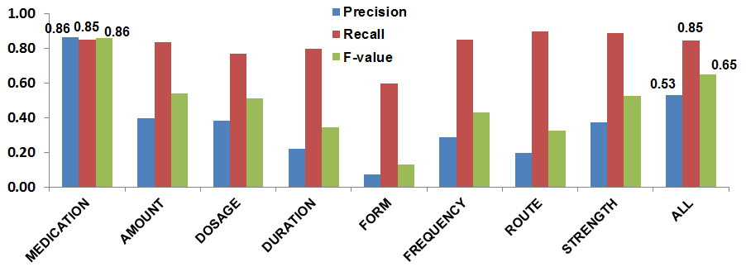
Results on Discr. Medications (Ideal)
Experiments & Evaluation
Results
Entity detection & linkage – 0.93/0.90/0.91 (P/R/F)
Medication matching (matched) – 0.92/0.91/0.92 (P/R/F)
Medication matching (discrepant) – 0.86/0.85/0.86 (P/R/F)
Notes:
18

Slide 19
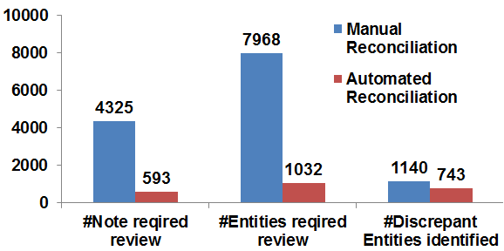
Workload of Medication Reconciliation
Experiments & Evaluation
Results
workload ↓ 87%
Notes:
19

Slide 20
Conclusions
Conclusions
  Medication entity detection → Attribute linkage → Medication Matching
  Hybrid Technologies
  Machine Learning
  Natural Language Processing
  Information Extraction
  Performance Summary
  Worked effectively on medication detection/attribute linkage
  Had promising performance on medication matching
  Substantial workload reduction potential
Notes:
20

Slide 21
Future Work
Future Work
  Refinement in the algorithm performance
  Prospective study
  Generalizability
Notes:
21

Slide 22
References
  Nickerson A, Mackinnon NJ, Roberts N, Saulnier L. Drug-therapy problems, inconsistencies and omissions identified during a medication reconciliation and seamless care service. Healthc Q. 2005;(Spec No):65-72.
  Wong JD, Bajcar JM, Wong GG, et al. Medication reconciliation at hospital discharge: evaluating discrepancies. Ann Pharmacother. 2008;42(10):1373-9.
  Cornu P, Steurbaut S, Leysen T, et al. Discrepancies in medication information for the primary care physician and the geriatric patient at discharge. Ann Pharmacother. 2012;46(7-8):983-90.
  Boockvar KS, Santos SL, Kushniruk A, et al. Medication reconciliation: barriers and facilitators from the perspectives of resident physicians and pharmacists. J Hosp Med. 2011;6(6):329-37.
  McCallum AC. MALLET: a machine learning for language toolkit [website]. 2002. Available at: http://mallet.cs.umass.edu
  Li Q, Zhai H, Deleger L, et al. A sequence labeling approach to link medications and their attributes in clinical notes and clinical trial announcements for information extraction. J Am Med Inform Assoc. 2013;20(5):915-21.
Notes:
22

Slide 23
Patient Population
Patient Population
  CCHMC Complex Care Medical Home Program
  Patients with multiple chronic illnesses and dependence on medical technologies (e.g. feeding tubes)
  Long medication lists, multiple care providers, frequent hospital -home care transitions
Notes:
23

