Slide 1
Towards comprehensive syntactic and semantic annotations of the clinical narrative
Daniel Albright, Arrick Lanfranchi, Anwen Fredriksen, William F Styler IV, Colin Warner, Jena D Hwang, Jinho D Choi, Dmitriy Dligach, Rodney D Nielsen, James Martin, Wayne Ward, Martha Palmer, Guergana K Savova
Albright D, Lanfranchi A, Fredriksen A, et al. JAMIA Dec 2012
doi:10.1136/amiajnl-2012-001317

Slide 2
Three projects
Corpus: clinical narrative text, anonymized from Mayo Clinic
  Pathology reports (colon cancer related)
  Mayo Clinic CN – randomly selected
Treebank
PropBank
3. UMLS – Unified Medical Language System
Notes:
Create a Gold Standard – Text annotated for UMLS entities manually
Gold Standard is used to train and evaluate algorithms

Slide 3
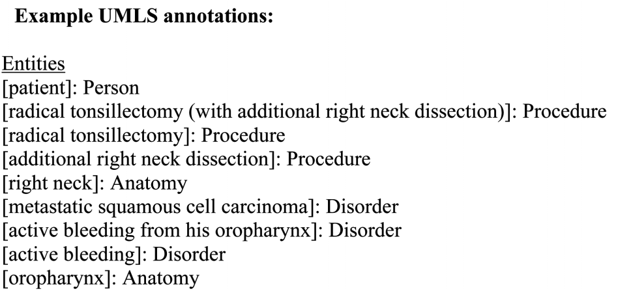
UMLS

Slide 4
Annotation Statistics
Named Entity Types
Corpus Statistics | Total
Sentences | 13091
Tokens | 127606
Predicate Lemmas PropBank | 1772
Named Entity 15 semantic Groups 1 semantic Type Person semantic category (non-UMLS) | 28539
Semantic Class | Proportion | Count
Procedures | 15.71% | 4483
Concepts & ideas | 15.10% | 4308
Disorders | 14.74% | 4208
Anatomy | 12.80% | 3652
Sign or Symptom | 12.46% | 3556
Chemicals and drugs | 7.49% | 2137
All Other | 21.7%
Notes:
130,000 tokens ~ = 300 notes

Slide 5
Annotation Statistics
Named Entity Types
Corpus Statistics | Total
Sentences | 13091
Tokens | 127606
Predicate Lemmas PropBank | 1772
Named Entity 15 semantic Groups 1 semantic Type Person semantic category (non-UMLS) | 28539
Semantic Class | Proportion | Count
Procedures | 15.71% | 4483
Concepts & ideas | 15.10% | 4308
Disorders | 14.74% | 4208
Anatomy | 12.80% | 3652
Sign or Symptom | 12.46% | 3556
Chemicals and drugs | 7.49% | 2137
All Other | 21.7%
Notes:
130,000 tokens ~ = 300 notes

Slide 6
IAA Results
 | Average IAA | Double Annotation Size
Treebank | 0.926 | 8%
PropBank, exact | 0.891 | 100%?
PropBank, Core-arg | 0.917 | 100%?
PropBank, Constituent | 0.931 | 100%?
UMLS, exact | 0.697 | 74%
UMLS, partial | 0.750 | 74%

Slide 7
Costs
Project | Cost | Startup %
Treebank | $100,000 | 70%
PropBank | $40,000 | <50%
UMLS | $50,000 – 60,000 | 33%

Slide 8
Tools Built on Annotations
(and incorporated into cTAKES)
POS tagger
Constituency parser
Dependency parser
Semantic role labeler

Slide 9
Tools Built on Annotations
(and incorporated into cTAKES)
Tool | Best result of MiPACQ training model
POS tagger | 94.28
Dependency Parser
-Labeled Attachment | 83.63
-Unlabeled Attach. | 85.72
Semantic Role Labeler
-Identification | 86.58
-Ident. + classification | 77.72

