Slide 1
MetaMap
UMLS Concept Mapping Program
Pawel Matykiewicz and Others

Slide 2
Outline
Input Formats (1)
The Algorithm (2)
MetaMap options (3)
Output Formats (4)
Creators (5)

Slide 3
Input Formats (1)
ASCII only input
Unformatted English free text
MEDLINE Citations
Input records delimited by blank line
Single-line delimited input (via job Scheduler)
heart attack
lung cancer
Single-line delimited input with ID (Scheduler)
000001|heart attack
000002|lung cancer

Slide 4
Input Should Have Syntactic Structure
Lack of structure → long phrases → combinatorial explosion in mappings
protein-4 FN3 fibronectin type III domain GSH lutathione GST glutathione S-transferase hIL-6 human interleukin-6 HSA human serum albumin IC(50) half-maximal inhibitory concentration Ig immunoglobulin IMAC immobilized metal affinity chromatography K(D) equilibrium constant
from filamentous bacteriophage f1 PCR polymerase-chain reaction PDB Protein Data Bank PSTI human pancreatic secretory trypsin inhibitor RBP retinol-binding protein SPR surface plasmon resonance TrxA

Slide 5
Be careful of bulleted lists!

Slide 6
The Algorithm (2)
Parsing
Using SPECIALIST minimal commitment parser, SPECIALIST lexicon, MedPost part of speech tagger
Variant generation
Using SPECIALIST lexicon, Lexical Variant Generation (LVG)
Candidate retrieval
From the Metathesaurus
Candidate evaluation
Mapping construction

Slide 7
Parsing
Text
Ocular complications of myasthenia gravis.
Tagging
Ocular complications of myasthenia gravis .
adj/2 noun prep noun noun/2 pd
Simplified phrases
[mod(ocular), head(complications)]
[prep(of), head(myasthenia gravis), punc(.)]

Slide 8
Variant Generation
Variants of adjective ocular (total 13, 9 occur in UMLS):
ocular{[adj], 0=[]}
eye{[noun], 2="s"}
eyes{[noun], 3="si"}
optic{[adj], 4="ss"}
ophthalmic{[adj], 4="ss"}
ophthalmia{[noun], 7="ssd"}
ophthalmias{[noun], 8="ssdi"}
ophthalmiac{[noun], 7="ssd"}
ophthalmiacs{[noun], 8="ssdi"}
oculus{[noun], 3="d"}
oculi{[noun], 4="di"}
ocularity{[noun], 3="d"}
ocularities{[noun], 4="di"}

Slide 9
Candidate Evaluation
Phrase: Ocular complications
Meta Candidates (8):
861 Complications (Complication) [patf]
861 complications (Complication Aspects) [patf]
777 Complicated [ftcn]
694 Ocular (Eye) [bpoc]
638 Eye (Entire Eye) [bpoc]
611 Optic (Optics) [ocdi]
611 Ophthalmic [spco]
588 Ophthalmia (Endophthalmitis) [dsyn]

Slide 10
Mapping Construction (WSD)
Cerebral blood flow (CBF) in newborn infants is
often below levels necessary to sustain brain viability
in adults.
Cerebrovascular Circulation
Infant, Newborn
CEREBRAL BLOOD FLOW IMAGING
Frequent
Levels (qualifier value)
Sustained
Brain
Viable
Entire brain
Adult

Slide 11
MetaMap Options (3)
Word Sense Disambiguation (WSD, -y)
Based on Susanne Humphrey’s Journal Descriptor Indexing (Humphrey et al., 1998, 2006)
Provides modest improvement in results
Negation (--negex)
Important for clinical text
Based on Wendy Chapman’s NegEx algorithm (Chapman et al., 2001)
Behavior options
Output/Display options

Slide 12
Behavior Options (1/4)
Data model options
-A --strict_model (the default; focused on concepts likely to be found in text)
-C --relaxed_model (includes most Metathesaurus content)
Major options highlighted earlier
-y --word_sense_disambiguation
--negex
Other major options
-Q --quick_composite_phrases (experimental, for well-behaved larger phrases: pain on the left side of the chest)
-i --ignore_word_order

Slide 13
Behavior Options (2/4)
Browse mode options (example below)
-z --term_processing
-o --allow_overmatches
-g --allow_concept_gaps
-m --hide_mappings
Inference mode options (example below)
-Y --prefer_multiple_concepts

Slide 14
Behavior Options (3/4)
Parsing/lexical options (not often used)
-t --no_tagging
-d --no_derivational_variants
-D --all_derivational_variants
-a --all_acros_abbrs
-u --unique_acros_abbrs_only
List truncation options (reduces tenuous matches and saves processing time)
-r --threshold <integer>

Slide 15
Behavior Options (4/4)
Source/ST limitation options
-R --restrict_to_sources <list>
-e --exclude_sources <list>
-J --restrict_to_sts <list>
-k --exclude_sts <list>

Slide 16
Behavior Example
“Superficial injury of chest wall without infection”
– prefer multiple concepts:
“Superficial”, “Injury”, “Chest”, “Wall”, “Infection” (time elapsed 0.39 sec)
– quick composite phrases:
Superficial”, “Injury of chest wall”, “Superficial injury of chest”, “Wall”, “Infection” (time elapsed 0.88 sec)
– term processing:
“Superficial injury of chest wall NOS, infected” (time elapsed 0.98 sec)
– term processing, – relaxed model:
“Superficial injury of chest wall without infection” (time elapsed 2.88 sec)

Slide 17
Output Formats (4)
Human-readable output
MetaMap Machine Output (MMO)
XML output
Colorized MetaMap output (MetaMap 3D)
Fielded (MMI) Output

Slide 18
Output Formats: Human Readable
Phrase: "heart attack"
Meta Candidates (8):
1000 Heart attack (Myocardial Infarction) [Disease or Syndrome]
861 Heart [Body Part, Organ, or Organ Component]
861 Attack, NOS (Onset of illness) [Finding]
861 Attack (Attack device) [Medical Device]
861 attack (Attack behavior) [Social Behavior]
861 Heart (Entire heart) [Body Part, Organ, or Organ Component]
861 Attack (Observation of attack) [Finding]
827 Attacked (Assault) [Injury or Poisoning]
Meta Mapping (1000):
1000 Heart attack (Myocardial Infarction) [Disease or Syndrome]

Slide 19
Output Formats: Machine Output
Prolog terms (pretty-printed & condensed!)
candidates([
ev(-1000, 'C0027051', 'Heart attack', 'Myocardial Infarction', [heart,attack],
[dsyn], [[[1,2],[1,2],0]], yes, no, ['MEDLINEPLUS], [0/12]),
ev(-861, 'C0018787', 'Heart', 'Heart', [heart],
[bpoc], [[[1,1],[1,1],0]], yes, no, ['AIR'],[0/5]),
ev(-861, 'C0277793', 'Attack, NOS', 'Onset of illness', [attack],
[fndg], [[[2,2],[1,1],0]], yes, no, ['MTH'], [6/6]),
ev(-861, 'C0699795', 'Attack', 'Attack device', [attack],
[medd], [[[2,2],[1,1],0]], yes, no, ['MTH','MMSL'], [6/6]),
ev(-861, 'C1261512', attack, 'Attack behavior', [attack],
[socb], [[[2,2],[1,1],0]], yes, no, ['MTH','PSY','AOD'], [6/6]),
ev(-861, 'C1281570', 'Heart', 'Entire heart', [heart],
[bpoc], [[[1,1],[1,1],0]], yes, no, ['MTH','SNOMEDCT'], [0/5]),
ev(-861, 'C1304680', 'Attack', 'Observation of attack', [attack],
[fndg], [[[2,2],[1,1],0]], yes, no, ['MTH','SNOMEDCT'], [6/6]),
ev(-827, 'C0004063', 'Attacked', 'Assault', [attacked],
[inpo], [[[2,2],[1,1],1]], yes, no, ['ICD10AM'], [6/6])]).

Slide 20
Output Formats: Formatted XML
<Candidate>
<CandidateScore>-1000</CandidateScore>
<CandidateCUI>C0027051</CandidateCUI>
<CandidateMatched>Heart attack</CandidateMatched>
<CandidatePreferred>Myocardial Infarction</CandidatePreferred>
<MatchedWords Count=2><MatchedWord>heart</MatchedWord><MatchedWord>attack</MatchedWord></MatchedWords>
<SemTypes Count=1><SemType>dsyn</SemType></SemTypes>
<MatchMaps Count=1>
<MatchMap>
<TextMatchStart>1</TextMatchStart>
<TextMatchEnd>2</TextMatchEnd>
<ConcMatchStart>1</ConcMatchStart>
<ConcMatchEnd>2</ConcMatchEnd>
<LexVariation>0</LexVariation>
</MatchMap>
</MatchMaps>
<IsHead>yes</IsHead>
<IsOverMatch>no</IsOverMatch>
<Sources Count=24><Source>MEDLINEPLUS</Source></Sources>
<ConceptPIs Count=1><ConceptPI><StartPos>0</StartPos><Length>12</Length></ConceptPI></ConceptPIs>
</Candidate>

Slide 21
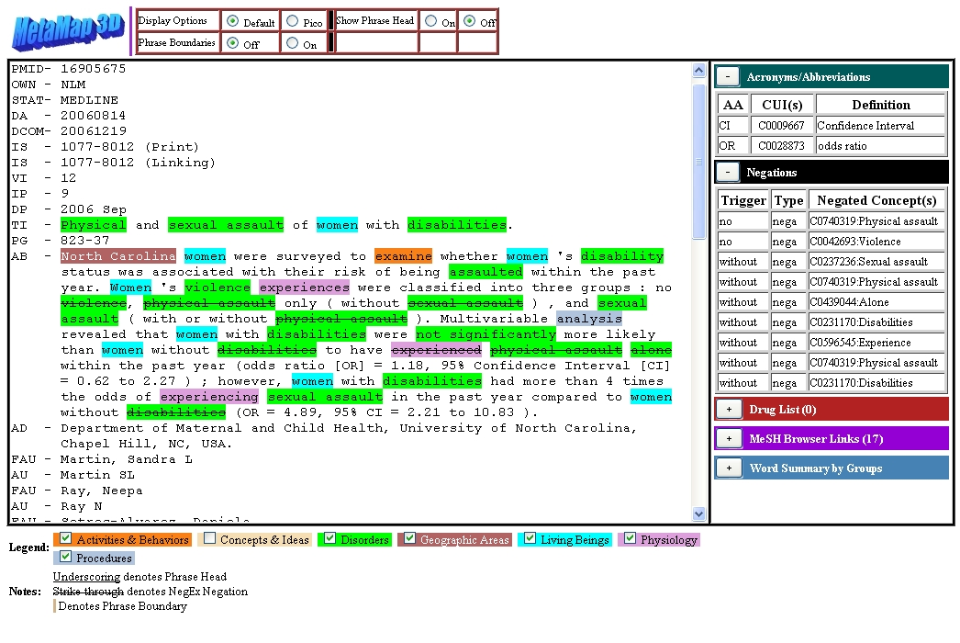
Output Formats: Colorized Output

Slide 22
MetaMap Fielded MMI Output
17285228|MM|430.78|Homocystine|C0019879|[aapp,bacs]|["Homocystine"-ab-3-"Homocysteine","Homocystine"-ab-2-"homocysteine","Homocystine"-ab-1-"Homocysteine","Homocystine"-ti-1-"homocysteine"]|TI;AB|406:12|227:12|74:12|35:12
17285228 (PMID)
MM (Path Name)
430.78 (Score)
Homocystine (UMLS Concept Found Preferred Name)
C0019879 (UMLS Concept Unique Identifier)
[aapp,bacs] (List of Semantic Type(s))
["Homocystine"-ab-3-"Homocysteine","Homocystine"-ab-2-"homocysteine","Homocystine"-ab-1-"Homocysteine","Homocystine"-ti-1-"homocysteine"] (List of Entry Term Quartets)
TI;AB (Location(s), boost scores for TI)
406:12|227:12|74:12|35:12 (List of Positional Information Groups [start:length])

Slide 23
Creators (5)
National Library of Medicine (NIH):
Alan (Lan) R. Aronson: alan@nlm.nih.gov
Dina Demner-Fushman: ddemner@mail.nih.gov
François-Michel Lang: flang@mail.nih.gov
James G. Mork: mork@nlm.nih.gov

Slide 24
Conclusions
Good for PubMed abstracts
Not so good for Clarity progress notes

